Slide 1
The OpenMP* Common Core: A hands-on Introduction
Tim Mattson
Intel Corp.
Yun (Helen) He
Berkeley Lab
Alice Koniges
Univ. of Hawai’i
David Eder
Univ. of Hawai’i
Download tutorial materials onto your laptop:
git clone https://github.com/tgmattso/OmpCommonCore.git
* The name “OpenMP” is the property of the OpenMP Architecture Review Board.

Slide 2
Preliminaries: Part 1
Disclosures
The views expressed in this tutorial are those of the people delivering the tutorial.
We are not speaking for our employers.
We are not speaking for the OpenMP ARB
We take these tutorials VERY seriously:
Help us improve … tell us how you would make this tutorial better.

Slide 3
Preliminaries: Part 2
Our plan for the day .. Active learning!
We will mix short lectures with short exercises.
You will use your laptop to connect to a multiprocessor server.
Please follow these simple rules
Do the exercises that we assign and then change things around and experiment.
Embrace active learning!
Don’t cheat: Do Not look at the solutions before you complete an exercise … even if you get really frustrated.

Slide 4

NERSC/LBNL Cori (Cray XC40)
9,688 Intel Knights Landing (KNL) compute nodes
68 cores per node, 4 hardware threads per core
Larger vector units (512 bits) with more complex instructions
96 GB DRAM, 16 GB on-package MCDRAM
2,388 Intel Xeon Haswell compute nodes: 32 cores/node
Cori KNL nodes are integrated with Haswell nodes on Aries network as one system
Choices of Intel, Cray, and GNU compilers
THANK YOU NERSC and their sponsor, the US DOE Office of Science.
Note: You can also do the exercises on your laptop if OpenMP is enabled. For example, on a Mac this can be done with homebrew or MacPorts. Installation instructions are provided at the end of the slide set.
*KNL: Intel® Xeon Phi™ processor 7250 with 68 cores @ 1.4 GHz
*Haswell: Intel® Xeon™ processor E5-2698 v3 @ 2.3 GHz

Slide 5
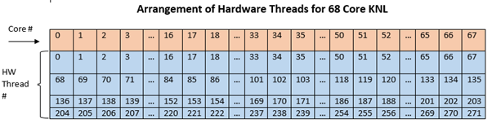
Compute Nodes (Cori KNL)
A Cori KNL node has 68 cores/272 CPUs, 96 GB DDR memory, 16 GB high bandwidth on package memory (MCDRAM)
A quad,cache node (default setting) has only 1 NUMA node with all CPUs on the NUMA node 0 (DDR memory). MCDRAM is hidden from the “numactl -H” result since it is a cache.
A quad,flat node has only 2 NUMA nodes with all CPUs on the NUMA node 0 (DDR memory). NUMA node 1 has MCDRAM only
A snc2,flat node has 4 NUMA domains with DDR memory and all CPUs on NUMA nodes 0 and 1

Slide 6
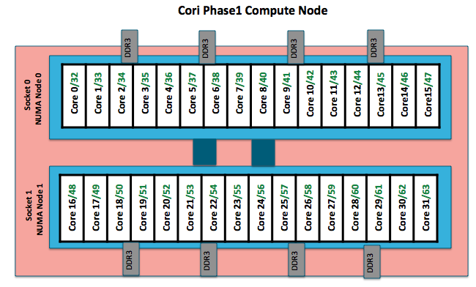
Compute Nodes (Cori Haswell*)
An Intel Haswell node has 32 cores (64 CPUs), 128 MB DDR memory.
2 NUMA domains per node, 16 cores per NUMA domain. 2 hardware threads (CPUs) per core.
Memory bandwidth is non-homogeneous among NUMA domains.
CPUs 0-15, 32-47 are closer to memory in NUMA domain 0, farther to memory in NUMA domain 1.
CPUs 16-31, 48-64 are closer to memory in NUMA domain 1, farther to memory in NUMA domain 0.
*Haswell: 16-core Intel® Xeon™ Processor E5-2698 v3 at 2.3 GHz

Slide 7
Cori Training Account and Exercises
Apply for a NERSC Cori training account
via ttps://iris.nersc.gov/train, use 4-letter code “erkE”, valid Nov 11-19, 2021
Access Cori via SSH
% ssh trainxxx@cori.nersc.gov
Obtain exercises, method 1
% cd $SCRATCH
% cp -r /global/cfs/cdirs/training/2021/OpenMP_SC21 . # notice the last dot
% cd OpenMP_SC21/C # or .../Fortran
Obtain exercises, method 2
% cd $SCRATCH
% git clone https://github.com/tgmattso/OmpCommonCore
% cd OmpCommonCore/Exercises/C # or …/Fortran

Slide 8
Compile and Run on Cori
The default compiler is Intel. Use compiler wrappers (ftn, cc, and CC) and the OpenMP compiler flag to build, such as:
% cc -qopenmp mycode.c
To use another compiler, such as gcc:
% module swap PrgEnv-intel PrgEnv-gnu
% cc -fopenmp mycode.c
To run on a compute node with an interactive batch session
Haswell node: % salloc -N 1 -C haswell -q regular --reservation=omp_hsw -t 30:00
KNL node: % salloc -N 1 -C knl -q regular --reservation=omp_knl -t 30:00
Set OMP_NUM_THREADS and other OpenMP environment variables if needed
Pure OpenMP code: % ./a.out
Hybrid MPI/OpenMP code: % srun -n .. -c … --cpu_bind=cores ./a.out

Slide 9
Outline
Introduction to OpenMP
Creating Threads
Synchronization
Parallel Loops
Data Environment
Memory Model
Irregular Parallelism and Tasks
Recap
Beyond the Common Core:
Worksharing Revisited
Synchronization Revisited: Options for Mutual exclusion
Thread Affinity and Data Locality
Thread Private Data
Memory Models and Point-to-Point Synchronization
Programming your GPU with OpenMP

Slide 10
OpenMP* Overview
C$OMP FLUSH
#pragma omp critical
#pragma omp single
C$OMP THREADPRIVATE(/ABC/)
C$OMP ATOMIC
CALL OMP_SET_NUM_THREADS(10)
OpenMP: An API for Writing Parallel Applications
A set of compiler directives and library routines for parallel application programmers
Greatly simplifies writing multi-threaded (MT) programs in Fortran, C and C++
Also supports non-uniform memories, vectorization and GPU programming
C$OMP parallel do shared(a, b, c)
call omp_test_lock(jlok)
call OMP_INIT_LOCK (ilok)
#pragma omp atomic capture
C$OMP TASKWAIT
C$OMP SINGLE PRIVATE(X)
C$OMP TASKGROUP
setenv OMP_SCHEDULE “dynamic”
C$OMP PARALLEL DO ORDERED PRIVATE (A, B, C)
C$OMP SECTIONS
C$OMP ORDERED
#pragma omp target teams distribute parallel for simd
!$OMP BARRIER
#pragma omp parallel for private(A, B)
C$OMP PARALLEL REDUCTION (+: A, B)
C$OMP PARALLEL COPYIN(/blk/)
C$OMP DO lastprivate(XX)
#pragma omp atomic seq_cst
Nthrds = OMP_GET_NUM_PROCS()
omp_set_lock(lck)
* The name “OpenMP” is the property of the OpenMP Architecture Review Board.

Slide 11
The Growth of Complexity in OpenMP
Our goal in 1997 … A simple interface for application programmers
Page Counts (not including front matter, indices or appendices) for OpenMP Specs
600
500
5.1*
Fortran spec
5.0*
C/C++ spec
5.2*_{tr10}
400
Merged C/C++ and Fortran spec
4.5
300
Page Counts
4.0
200
3.0
3.1
2.5
100
2.0
1.0
1.1
1.0
2.0
0
1995
2000
2005
2010
2015
2020
2025
The full spec is overwhelming. We focus on the Common Core: the 21 items most people restrict themselves to

Slide 12
The OpenMP Common Core: Most OpenMP programs only use these 21 items
OpenMP pragma, function, or clause | Concepts
#pragma omp parallel | Parallel region, teams of threads, structured block, interleaved execution across threads.
void omp_set_thread_num() int omp_get_thread_num() int omp_get_num_threads() | Default number of threads and internal control variables. SPMD pattern: Create threads with a parallel region and split up the work using the number of threads and the thread ID.
double omp_get_wtime() | Speedup and Amdahl's law. False sharing and other performance issues.
setenv OMP_NUM_THREADS N | Setting the internal control variable for the default number of threads with an environment variable
#pragma omp barrier #pragma omp critical | Synchronization and race conditions. Revisit interleaved execution.
#pragma omp for #pragma omp parallel for | Worksharing, parallel loops, loop carried dependencies.
reduction(op:list) | Reductions of values across a team of threads.
schedule (static [,chunk]) schedule(dynamic [,chunk]) | Loop schedules, loop overheads, and load balance.
shared(list), private(list), firstprivate(list) | Data environment.
default(none) | Force explicit definition of each variable’s storage attribute
nowait | Disabling implied barriers on workshare constructs, the high cost of barriers, and the flush concept (but not the flush directive).
#pragma omp single | Workshare with a single thread.
#pragma omp task #pragma omp taskwait | Tasks including the data environment for tasks.

Slide 13
OpenMP Basic Definitions: Basic Solution Stack
End User
User layer
Application
Prog. Layer
Directives,
Compiler
OpenMP library
Environment variables
OpenMP Runtime library
System layer
OS/system support for shared memory and threading
HW
Shared address space (NUMA)
CPU cores
SIMD units
GPU cores
13

Slide 14

OpenMP Basic Definitions: Basic Solution Stack
End User
User layer
Application
Prog. Layer
Directives,
Compiler
OpenMP library
Environment variables
OpenMP Runtime library
System layer
OS/system support for shared memory and threading
. . .
HW
Shared address space (SMP)
For the OpenMP Common Core, we focus on Symmetric Multiprocessor Case …. i.e., lots of threads with “equal cost access” to memory

Slide 15
OpenMP Basic Syntax
Most of the constructs in OpenMP are compiler directives.
C and C++ | Fortran
Compiler directives
#pragma omp construct [clause [clause]…] | !$OMP construct [clause [clause] …]
Example
#pragma omp parallel private(x) { } | !$OMP PARALLEL PRIVATE(X) !$OMP END PARALLEL
Function prototypes and types:
#include <omp.h> | use OMP_LIB
Most OpenMP constructs apply to a “structured block”.
Structured block: a block of one or more statements with one point of entry at the top and one point of exit at the bottom.
It’s OK to have an exit() within the structured block.

Slide 16
Exercise, Part A: Hello World Verify that your environment works
Write a program that prints “hello world”.
git clone https://github.com/tgmattso/OpenMPCommonCore.git
#include<stdio.h> int main() {
printf(“ hello ”); printf(“ world \n”); }
To download the slides:
https://github.com/tgmattso/OmpCommonCore.git

Slide 17
Exercise, Part B: Hello World Verify that your OpenMP environment works
Write a multithreaded program that prints “hello world”.
git clone https://github.com/tgmattso/OpenMP_Common_Core.git
#include <stdio.h> int main() {
printf(“ hello ”); printf(“ world \n”);
}
#include <omp.h>
Switches for compiling and linking
gcc -fopenmp Gnu (Linux, OSX)
cc -qopenmp Intel (Linux@NERSC)
icl /Qopenmp Intel (windows)
icc -fopenmp Intel (Linux, OSX)
#pragma omp parallel
{
}

Slide 18
Solution A Multi-Threaded “Hello World” Program
Write a multithreaded program where each thread prints “hello world”.
#include <omp.h> #include <stdio.h> int main() {
#pragma omp parallel {
printf(“ hello ”); printf(“ world \n”); } }
OpenMP include file
Sample Output:
hello hello world
world
hello hello world
world
Parallel region with default number of threads
End of the Parallel region
The statements are interleaved based on how the operating schedules the threads

Slide 19
Outline
Introduction to OpenMP
Creating Threads
Synchronization
Parallel Loops
Data Environment
Memory Model
Irregular Parallelism and Tasks
Recap
Beyond the Common Core:
Worksharing Revisited
Synchronization Revisited: Options for Mutual exclusion
Thread Affinity and Data Locality
Thread Private Data
Memory Models and Point-to-Point Synchronization
Programming your GPU with OpenMP

Slide 20
OpenMP Execution model:
Fork-Join Parallelism:
Initial thread spawns a team of threads as needed.
Parallelism added incrementally until performance goals are met, i.e., the sequential program evolves into a parallel program.
Parallel Regions
A Nested Parallel Region
Initial Thread
Sequential Parts

Slide 21
Thread Creation: Parallel Regions
You create threads in OpenMP* with the parallel construct.
For example, to create a 4 thread Parallel region:
double A[1000]; omp_set_num_threads(4); #pragma omp parallel { int ID = omp_get_thread_num(); pooh(ID,A); }
Runtime function to request a certain number of threads
Each thread executes a copy of the code within the structured block
Runtime function returning a thread ID
Each thread calls pooh(ID,A) for ID = 0 to 3

Slide 22
Thread Creation: Parallel Regions Example
double A[1000]; omp_set_num_threads(4);
#pragma omp parallel {
int ID = omp_get_thread_num(); pooh(ID, A); }
printf(“all done\n”);
Each thread executes the same code redundantly.
double A[1000];
omp_set_num_threads(4)
A single copy of A is shared between all threads.
pooh(0,A)
pooh(1,A)
pooh(2,A)
pooh(3,A)
printf(“all done\n”);
Threads wait here for all threads to finish before proceeding (i.e., a barrier)
22

Slide 23
Thread creation: How many threads did you actually get?
Request a number of threads with omp_set_num_threads()
The number requested may not be the number you actually get.
An implementation may silently give you fewer threads than you requested.
Once a team of threads has launched, it will not be reduced.
double A[1000]; omp_set_num_threads(4); #pragma omp parallel { int ID = omp_get_thread_num();
int nthrds = omp_get_num_threads(); pooh(ID,A); }
Runtime function to request a certain number of threads
Each thread executes a copy of the code within the structured block
Runtime function to return actual number of threads in the team
Each thread calls pooh(ID,A) for ID = 0 to nthrds-1

Slide 24
An Interesting Problem to Play With Numerical Integration
Mathematically, we know that:
1
4.0
∫
4.0
dx = π
(1+x²)
0
We can approximate the integral as a sum of rectangles:
2.0
F(x) = 4.0/(1+x²)
N
N
∑ F(x_{i})Δx = Δx ∑ F(x_{i}) ≈ π
i = 0
i = 0
Where each rectangle has width Δx and height F(x_{i}) at the middle of interval i.
0.0
X
1.0

Slide 25
Serial PI Program
static long num_steps = 100000;
double step;
int main ()
{ int i; double x, pi, sum = 0.0;
step = 1.0/(double) num_steps;
for (i=0;i< num_steps; i++){
x = (i+0.5)*step;
sum = sum + 4.0/(1.0+x*x);
}
pi = step * sum;
}
See ParProgCourse/Exercises/OpenMP/pi.c

Slide 26
Serial PI Program
#include <omp.h>
static long num_steps = 100000;
double step;
int main ()
{ int i; double x, pi, sum = 0.0;
step = 1.0/(double) num_steps;
double tdata = omp_get_wtime();
for (i=0;i< num_steps; i++){
x = (i+0.5)*step;
sum = sum + 4.0/(1.0+x*x);
}
pi = step * sum;
tdata = omp_get_wtime() - tdata;
printf(“ pi = %f in %f secs\n”,pi, tdata);
}
The library routine get_omp_wtime() is used to find the elapsed “wall time” for blocks of code
See ParProgCourse/Exercises/OpenMP/pi.c

Slide 27
Exercise: the Parallel Pi Program
Create a parallel version of the pi program using a parallel construct:
#pragma omp parallel
Pay close attention to shared versus private variables.
In addition to a parallel construct, you will need the runtime library routines
int omp_get_num_threads();
int omp_get_thread_num();
double omp_get_wtime();
omp_set_num_threads();
Number of threads in the team
Thread ID or rank
Time in seconds since a fixed point in the past
Request a number of threads in the team

Slide 28
Hints: the Parallel Pi Program
Use a parallel construct:
#pragma omp parallel
The challenge is to:
divide loop iterations between threads (use the thread ID and the number of threads).
Create an accumulator for each thread to hold partial sums that you can later combine to generate the global sum.
In addition to a parallel construct, you will need the runtime library routines
int omp_set_num_threads();
int omp_get_num_threads();
int omp_get_thread_num();
double omp_get_wtime();

Slide 29
Example: A simple SPMD pi program
#include <omp.h>
static long num_steps = 100000; double step;
#define NUM_THREADS 2
void main ()
{ int i, nthreads; double pi, sum[NUM_THREADS];
step = 1.0/(double) num_steps;
omp_set_num_threads(NUM_THREADS);
#pragma omp parallel
{
int i, id,nthrds;
double x;
id = omp_get_thread_num();
nthrds = omp_get_num_threads();
if (id == 0) nthreads = nthrds;
for (i=id, sum[id]=0.0;i< num_steps; i=i+nthrds) {
x = (i+0.5)*step;
sum[id] += 4.0/(1.0+x*x);
}
}
for(i=0, pi=0.0;i<nthreads;i++)pi += sum[i] * step;
}
Promote scalar to an array dimensioned by number of threads to avoid race condition.
Only one thread should copy the number of threads to the global value to make sure multiple threads writing to the same address don’t conflict.
This is a common trick in SPMD programs to create a cyclic distribution of loop iterations

Slide 30
Results*
Original Serial pi program with 100000000 steps ran in 1.83 seconds.
threads | 1st SPMD*
1 | 1.86
2 | 1.03
3 | 1.08
4 | 0.97
Intel compiler (icpc) with default optimization level (O2) on Apple OS X 10.7.3 with a dual core (four HW thread) Intel® CoreTM i5 processor at 1.7 Ghz and 4 Gbyte DDR3 memory at 1.333 Ghz.
*SPMD: Single Program Multiple Data

Slide 31
SPMD: Single Program Mulitple Data
Run the same program on P processing elements where P can be arbitrarily large.
Replicate the program.
Add glue code
Break up the data
Use the rank … an ID ranging from 0 to (P-1) … to select between a set of tasks and to manage any shared data structures.
MPI programs almost always use this pattern … it is probably the most commonly used pattern in the history of parallel programming.

Slide 32
Why Such Poor Scaling? False Sharing
If independent data elements happen to sit on the same cache line, each update will cause the cache lines to “slosh back and forth” between threads … This is called “false sharing”.
HW thrd. 0
HW thrd. 1
HW thrd. 2
HW thrd. 3
L1 $ lines
L1 $ lines
Sum[0] | Sum[1] | Sum[2] | Sum[3]
Sum[0] | Sum[1] | Sum[2] | Sum[3]
Core 0
Core 1
Shared last level cache and connection to I/O and DRAM
If you promote scalars to an array to support creation of an SPMD program, the array elements are contiguous in memory and hence share cache lines … Results in poor scalability.
Solution: Pad arrays so elements you use are on distinct cache lines.

Slide 33
Example: Eliminate false sharing by padding the sum array
#include <omp.h>
static long num_steps = 100000; double step;
#define NUM_THREADS 2
#define PAD 8 // assume 64 byte L1 cache line size
void main ()
{ int i, nthreads; double pi, sum[NUM_THREADS][PAD] ;
step = 1.0/(double) num_steps;
omp_set_num_threads(NUM_THREADS);
#pragma omp parallel
{
int i, id,nthrds;
double x;
id = omp_get_thread_num();
nthrds = omp_get_num_threads();
if (id == 0) nthreads = nthrds;
for (i=id, sum[id]=0.0;i< num_steps; i=i+nthrds) {
x = (i+0.5)*step;
sum[id][0] += 4.0/(1.0+x*x);
}
}
for(i=0, pi=0.0;i<nthreads;i++)pi += sum[i][0] * step;
}
Pad the array so each sum value is in a different cache line

Slide 34
Results*: PI Program, Padded Accumulator
Original Serial pi program with 100000000 steps ran in 1.83 seconds.
threads | 1st SPMD | 1st SPMD padded
1 | 1.86 | 1.86
2 | 1.03 | 1.01
3 | 1.08 | 0.69
4 | 0.97 | 0.53
*Intel compiler (icpc) with default optimization level (O2) on Apple OS X 10.7.3 with a dual core (four HW thread) Intel® CoreTM i5 processor at 1.7 Ghz and 4 Gbyte DDR3 memory at 1.333 Ghz.

Slide 35
Four Ways to Request a Number of Threads for a Parallel Region
The system has an Internal Control Variable (ICV) that defines the default number of threads to request for a parallel region.
When an OpenMP program starts up, it queries an environment variable OMP_NUM_THREADS and sets the appropriate internal control variable to the value of OMP_NUM_THREADS
For example, to set the default number of threads on my apple laptop
export OMP_NUM_THREADS=12
The omp_set_num_threads() runtime function overrides the value from the environment and resets the ICV to a new value.
A clause on the parallel construct requests a number of threads for that parallel region, but it does not change the ICV
#pragma omp parallel num_threads(4)
Order of Precedence for setting the requested number of threads: (4) > (3) > (2) > (1)

Slide 36
Outline
Introduction to OpenMP
Creating Threads
Synchronization
Parallel Loops
Data Environment
Memory Model
Irregular Parallelism and Tasks
Recap
Beyond the Common Core:
Worksharing Revisited
Synchronization Revisited: Options for Mutual exclusion
Thread Affinity and Data Locality
Thread Private Data
Memory Models and Point-to-Point Synchronization
Programming your GPU with OpenMP

Slide 37
Synchronization
Synchronization is used to impose order constraints and to protect access to shared data
High level synchronization included in the common core:
critical
barrier
Other, more advanced, synchronization operations:
atomic
ordered
flush
locks (both simple and nested)

Slide 38
Synchronization: critical
Mutual exclusion: Only one thread at a time can enter a critical region.
float res;
#pragma omp parallel
{ float B; int i, id, nthrds;
id = omp_get_thread_num();
nthrds = omp_get_num_threads();
B = big_SPMD_job(id, nthrds);
#pragma omp critical res += consume (B);
}
Threads wait their turn – only one thread at a time calls consume()

Slide 39
Synchronization: barrier
Barrier: a point in a program all threads much reach before any threads are allowed to proceed.
It is a “stand alone” pragma meaning it is not associated with user code … it is an executable statement.
double Arr[8], Brr[8]; int numthrds;
omp_set_num_threads(8)
#pragma omp parallel
{ int id, nthrds;
id = omp_get_thread_num();
nthrds = omp_get_num_threads();
if (id==0) numthrds = nthrds;
Arr[id] = big_ugly_calc(id, nthrds);
#pragma omp barrier Brr[id] = really_big_and_ugly(id, nthrds, Arr); }
Threads wait until all threads hit the barrier. Then they can go on.

Slide 40
Exercise
In your first Pi program, you probably used an array to create space for each thread to store its partial sum.
If array elements happen to share a cache line, this leads to false sharing.
Non-shared data in the same cache line so each update invalidates the cache line … in essence “sloshing independent data” back and forth between threads.
Modify your “pi program” to avoid false sharing due to the partial sum array.
int omp_get_num_threads();
int omp_get_thread_num();
double omp_get_wtime();
omp_set_num_threads();
#pragma parallel
#pragma critical

Slide 41
PI Program with False Sharing
Original Serial pi program with 100000000 steps ran in 1.83 seconds.
Recall that promoting sum to an array made the coding easy, but led to false sharing and poor performance.
threads | 1st SPMD
1 | 1.86
2 | 1.03
3 | 1.08
4 | 0.97
*Intel compiler (icpc) with no optimization on Apple OS X 10.7.3 with a dual core (four HW thread) Intel® CoreTM i5 processor at 1.7 Ghz and 4 Gbyte DDR3 memory at 1.333 Ghz.

Slide 42
Example: Using a critical section to remove impact of false sharing
#include <omp.h>
static long num_steps = 100000; double step;
#define NUM_THREADS 2
void main ()
{ int nthreads; double pi=0.0; step = 1.0/(double) num_steps;
omp_set_num_threads(NUM_THREADS);
#pragma omp parallel
{
int i, id, nthrds; double x, sum;
id = omp_get_thread_num();
nthrds = omp_get_num_threads();
if (id == 0) nthreads = nthrds;
for (i=id, sum=0.0;i< num_steps; i=i+nthrds) {
x = (i+0.5)*step;
sum += 4.0/(1.0+x*x);
}
#pragma omp critical
pi += sum * step;
}
}
Create a scalar local to each thread to accumulate partial sums.
No array, so no false sharing.
Sum goes “out of scope” beyond the parallel region … so you must sum it in here. Must protect summation into pi in a critical region so updates don’t conflict

Slide 43
Results*: pi program critical section
Original Serial pi program with 100000000 steps ran in 1.83 seconds.
threads | 1st SPMD | 1st SPMD padded | SPMD critical
1 | 1.86 | 1.86 | 1.87
2 | 1.03 | 1.01 | 1.00
3 | 1.08 | 0.69 | 0.68
4 | 0.97 | 0.53 | 0.53
*Intel compiler (icpc) with no optimization on Apple OS X 10.7.3 with a dual core (four HW thread) Intel® CoreTM i5 processor at 1.7 Ghz and 4 Gbyte DDR3 memory at 1.333 Ghz.

Slide 44
Example: Using a critical section to remove impact of false sharing
#include <omp.h>
static long num_steps = 100000; double step;
#define NUM_THREADS 2
void main ()
{ int nthreads; double pi=0.0; step = 1.0/(double) num_steps;
omp_set_num_threads(NUM_THREADS);
#pragma omp parallel
{
int i, id, nthrds; double x, sum;
id = omp_get_thread_num();
nthrds = omp_get_num_threads();
if (id == 0) nthreads = nthrds;
for (i=id, sum=0.0;i< num_steps; i=i+nthrds) {
x = (i+0.5)*step;
#pragma omp critical
sum += 4.0/(1.0+x*x);
}
}
}
What would happen if you put the critical section inside the loop?

Slide 45
Outline
Introduction to OpenMP
Creating Threads
Synchronization
Parallel Loops
Data Environment
Memory Model
Irregular Parallelism and Tasks
Recap
Beyond the Common Core:
Worksharing Revisited
Synchronization Revisited: Options for Mutual exclusion
Thread Affinity and Data Locality
Thread Private Data
Memory Models and Point-to-Point Synchronization
Programming your GPU with OpenMP

Slide 46
The Loop Worksharing Construct
The loop worksharing construct splits up loop iterations among the threads in a team
#pragma omp parallel
{ #pragma omp for for (I=0;I<N;I++){ NEAT_STUFF(I); } }
Loop construct name:
C/C++: for
Fortran: do
The loop control index I is made “private” to each thread by default.
Threads wait here until all threads are finished with the parallel loop before any proceed past the end of the loop

Slide 47
Loop Worksharing Construct A motivating example
Sequential code
for(i=0;i<N;i++) { a[i] = a[i] + b[i];}
#pragma omp parallel { int id, i, Nthrds, istart, iend; id = omp_get_thread_num(); Nthrds = omp_get_num_threads(); istart = id * N / Nthrds; iend = (id+1) * (N / Nthrds)-1; if (id == Nthrds-1)iend = N; for(i=istart;i<iend;i++) { a[i] = a[i] + b[i];} }
OpenMP parallel region
(SPMD Pattern)
OpenMP parallel region and a worksharing for construct
#pragma omp parallel #pragma omp for for(i=0;i<N;i++) { a[i] = a[i] + b[i];}

Slide 48
Loop Worksharing Constructs: The schedule clause
The schedule clause affects how loop iterations are mapped onto threads
schedule(static [,chunk])
Deal-out blocks of iterations of size “chunk” to each thread.
schedule(dynamic[,chunk])
Each thread grabs “chunk” iterations off a queue until all iterations have been handled.
Example:
#pragma omp for schedule(dynamic, 10)
Schedule Clause | When To Use
STATIC | Pre-determined and predictable by the programmer
DYNAMIC | Unpredictable, highly variable work per iteration
Least work at runtime : scheduling done at compile-time
Most work at runtime : complex scheduling logic used at run-time

Slide 49
Combined Parallel/Worksharing Construct
OpenMP shortcut: Put the “parallel” and the worksharing directive on the same line
double res[MAX]; int i;
#pragma omp parallel
{
#pragma omp for
for (i=0;i< MAX; i++) {
res[i] = huge();
}
}
double res[MAX]; int i;
#pragma omp parallel for
for (i=0;i< MAX; i++) {
res[i] = huge();
}
These are equivalent

Slide 50
Working with loops
Basic approach
Find compute intensive loops
Make the loop iterations independent ... So they can safely execute in any order without loop-carried dependencies
Place the appropriate OpenMP directive and test
Note: loop index “i” is private by default
int i, j, A[MAX];
j = 5;
for (i=0;i< MAX; i++) {
j +=2;
A[i] = big(j);
}
int i, A[MAX];
#pragma omp parallel for
for (i=0;i< MAX; i++) {
int j = 5 + 2*(i+1);
A[i] = big(j);
}
Remove loop carried dependence

Slide 51
Reduction
How do we handle this case?
double ave=0.0, A[MAX];
int i;
for (i=0;i< MAX; i++) {
ave + = A[i];
}
ave = ave/MAX;
We are combining values into a single accumulation variable (ave) … there is a true dependence between loop iterations that can’t be trivially removed.
This is a very common situation … it is called a “reduction”.
Support for reduction operations is included in most parallel programming environments.

Slide 52
Reduction
OpenMP reduction clause:
reduction (op : list)
Inside a parallel or a work-sharing construct:
A local copy of each list variable is made and initialized depending on the “op” (e.g. 0 for “+”).
Updates occur on the local copy.
Local copies are reduced into a single value and combined with the original global value.
The variables in “list” must be shared in the enclosing parallel region.
double ave=0.0, A[MAX]; int i;
#pragma omp parallel for reduction (+:ave)
for (i=0;i< MAX; i++) {
ave + = A[i];
}
ave = ave/MAX;

Slide 53
OpenMP: Reduction operands/initial-values
Many different associative operands can be used with reduction:
Initial values are the ones that make sense mathematically.
Operator | Initial value
+ | 0
* | 1
- | 0
min | Largest pos. number
max | Most neg. number
Fortran Only
Operator | Initial value
.AND. | .true.
.OR. | .false.
.NEQV. | .false.
.IEOR. | 0
.IOR. | 0
.IAND. | All bits on
.EQV. | .true.
C/C++ only
Operator | Initial value
& | ~0
| | 0
^ | 0
&& | 1
|| | 0
OpenMP includes user defined reductions and array-sections as reduction variables (we just don’t cover those topics here)

Slide 54
Exercise: PI with loops
Go back to the serial pi program and parallelize it with a loop construct
Your goal is to minimize the number of changes made to the serial program.
#pragma omp parallel
#pragma omp for
#pragma omp parallel for
#pragma omp for reduction(op:list)
#pragma omp critical
int omp_get_num_threads();
int omp_get_thread_num();
double omp_get_wtime();

Slide 55
Example: PI with a loop and a reduction
#include <omp.h>
static long num_steps = 100000; double step;
void main ()
{ int i; double x, pi, sum = 0.0;
step = 1.0/(double) num_steps;
#pragma omp parallel
{
double x;
#pragma omp for reduction(+:sum)
for (i=0;i< num_steps; i++){
x = (i+0.5)*step;
sum = sum + 4.0/(1.0+x*x);
}
}
pi = step * sum;
}
Create a team of threads … without a parallel construct, you’ll never have more than one thread
Create a scalar local to each thread to hold value of x at the center of each interval
Break up loop iterations and assign them to threads … setting up a reduction into sum. Note … the loop index is local to a thread by default.

Slide 56
Example: PI with a loop and a reduction
#include <omp.h>
static long num_steps = 100000; double step;
void main ()
{
double pi, sum = 0.0;
step = 1.0/(double) num_steps;
#pragma omp parallel for reduction(+:sum)
for (int i=0;i< num_steps; i++){
double x = (i+0.5)*step;
sum = sum + 4.0/(1.0+x*x);
}
pi = step * sum;
}
Using modern C style, we put declarations close to where they are used … which lets me use the parallel for construct.

Slide 57
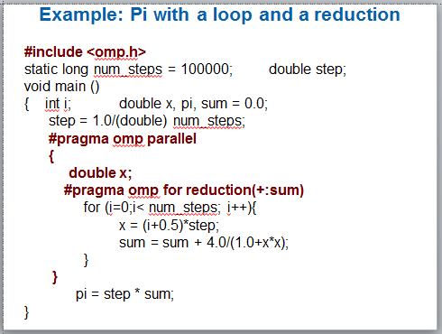
Results*: PI with a loop and a reduction
Original Serial pi program with 100000000 steps ran in 1.83 seconds.
threads | 1st SPMD | 1st SPMD padded | SPMD critical | PI Loop
1 | 1.86 | 1.86 | 1.87 | 1.91
2 | 1.03 | 1.01 | 1.00 | 1.02
3 | 1.08 | 0.69 | 0.68 | 0.80
4 | 0.97 | 0.53 | 0.53 | 0.68
*Intel compiler (icpc) with no optimization on Apple OS X 10.7.3 with a dual core (four HW thread) Intel® CoreTM i5 processor at 1.7 Ghz and 4 Gbyte DDR3 memory at 1.333 Ghz.

Slide 58
The nowait clause
Barriers are really expensive. You need to understand when they are implied and how to skip them when it’s safe to do so.
double A[big], B[big], C[big];
#pragma omp parallel { int id=omp_get_thread_num(); A[id] = big_calc1(id); #pragma omp barrier #pragma omp for for(i=0;i<N;i++){C[i]=big_calc3(i,A);} #pragma omp for nowait for(i=0;i<N;i++){ B[i]=big_calc2(C, i); } A[id] = big_calc4(id); }
implicit barrier at the end of a for worksharing construct
implicit barrier at the end of a parallel region
no implicit barrier due to nowait

Slide 59
Outline
Introduction to OpenMP
Creating Threads
Synchronization
Parallel Loops
Data Environment
Memory Model
Irregular Parallelism and Tasks
Recap
Beyond the Common Core:
Worksharing Revisited
Synchronization Revisited: Options for Mutual exclusion
Thread Affinity and Data Locality
Thread Private Data
Memory Models and Point-to-Point Synchronization
Programming your GPU with OpenMP

Slide 60
Data Environment: Default storage attributes
Shared memory programming model:
Most variables are shared by default
Global variables are SHARED among threads
Fortran: COMMON blocks, SAVE variables, MODULE variables
C: File scope variables, static
Both: dynamically allocated memory (ALLOCATE, malloc, new)
But not everything is shared...
Stack variables in subprograms(Fortran) or functions(C) called from parallel regions are PRIVATE
Automatic variables within a statement block are PRIVATE.

Slide 61
Data Sharing: Examples
double A[10];
int main() {
int index[10];
#pragma omp parallel
work(index);
printf(“%d\n”, index[0]);
}
extern double A[10];
void work(int *index) {
double temp[10];
static int count;
...
}
A, index, count
A, index and count are shared by all threads.
temp is local to each thread
temp
temp
temp
A, index, count

Slide 62
Data Sharing: Changing storage attributes
One can selectively change storage attributes for constructs using the following clauses* (note: list is a comma-separated list of variables)
shared(list)
private(list)
firstprivate(list)
These can be used on parallel and for constructs … other than shared which can only be used on a parallel construct
Force the programmer to explicitly define storage attributes
default (none)
default() can only be used on parallel constructs

Slide 63
Data Sharing: Private clause
private(var) creates a new local copy of var for each thread.
int N = 1000;
extern void init_arrays(int N, double *A, double *B, double *C);
void example () {
int i, j;
double A[N][N], B[N][N], C[N][N];
init_arrays(N, *A, *B, *C);
#pragma omp parallel for private(j)
for (i = 0; i < 1000; i++)
for( j = 0; j<1000; j++)
C[i][j] = A[i][j] + B[i][j];
}
OpenMP makes the loop control index on the parallel loop (i) private by default … but not for the second loop (j)

Slide 64
Data Sharing: Private clause
private(var) creates a new local copy of var for each thread.
The value of the private copies is uninitialized
The value of the original variable is unchanged after the region
void wrong() {
int tmp = 0;
#pragma omp parallel for private(tmp)
for (int j = 0; j < 1000; ++j)
tmp += j;
printf(“%d\n”, tmp);
}
tmp was not initialized
When you need to refer to the variable tmp that exists prior to the construct, we call it the original variable.
tmp is 0 here

Slide 65
Data Sharing: Private and the original variable
The original variable’s value is unspecified if it is referenced outside of the construct
Implementations may reference the original variable or a copy ….. a dangerous programming practice!
For example, consider what would happen if the compiler inlined work()?
int tmp;
void danger() {
tmp = 0;
#pragma omp parallel private(tmp)
work();
printf(“%d\n”, tmp);
}
extern int tmp;
void work() {
tmp = 5;
}
unspecified which copy of tmp
tmp has unspecified value

Slide 66
Firstprivate clause
Variables initialized from a shared variable
C++ objects are copy-constructed
incr = 0;
#pragma omp parallel for firstprivate(incr)
for (i = 0; i <= MAX; i++) {
if ((i%2)==0) incr++;
A[i] = incr;
}
Each thread gets its own copy of incr with an initial value of 0
66
Notes:
Script:
More detail on the firstprivateprivate clause
Next foil
Background

Slide 67
Data sharing: A data environment test
Consider this example of PRIVATE and FIRSTPRIVATE
Are A,B,C private to each thread or shared inside the parallel region?
What are their initial values inside and values after the parallel region?
variables: A = 1,B = 1, C = 1 #pragma omp parallel private(B) firstprivate(C)
Inside this parallel region ...
“A” is shared by all threads; equals 1
“B” and “C” are private to each thread.
B’s initial value is undefined
C’s initial value equals 1
Following the parallel region ...
B and C revert to their original values of 1
A is either 1 or the value it was set to inside the parallel region

Slide 68
Data Sharing: Default clause
default(none): Forces you to define the storage attributes for variables that appear inside the static extent of the construct … if you fail the compiler will complain. Good programming practice!
You can put the default clause on parallel and parallel + workshare constructs.
#include <omp.h>
int main()
{
int i, j=5; double x=1.0, y=42.0;
#pragma omp parallel for default(none) reduction(*:x)
for (i=0;i<N;i++){
for(j=0; j<3; j++)
x+= foobar(i, j, y);
}
printf(“ x is %f\n”,(float)x);
}
The static extent is the code in the compilation unit that contains the construct.
The compiler would complain about j and y, which is important since you don’t want j to be shared
The full OpenMP specification has other versions of the default clause, but they are not used very often so we skip them in the common core

Slide 69
Exercise: Mandelbrot set area
The supplied program (mandel.c) computes the area of a Mandelbrot set.
The program has been parallelized with OpenMP, but we were lazy and didn’t do it right.
Find and fix the errors (hint … the problem is with the data environment).
Once you have a working version, try to optimize the program.
Try different schedules on the parallel loop.
Try different mechanisms to support mutual exclusion … do the efficiencies change?
This exercises come from Mark Bull of EPCC (at University of Edinburgh)

Slide 70
The Mandelbrot Set Area Program
#include <omp.h>
# define NPOINTS 1000
# define MXITR 1000
struct d_complex{
double r; double i;
};
void testpoint(struct d_complex);
struct d_complex c;
int numoutside = 0;
int main(){
int i, j;
double area, error, eps = 1.0e-5;
#pragma omp parallel for private(c, j) firstprivate(eps)
for (i=0; i<NPOINTS; i++) {
for (j=0; j<NPOINTS; j++) {
c.r = -2.0+2.5*(double)(i)/(double)(NPOINTS)+eps;
c.i = 1.125*(double)(j)/(double)(NPOINTS)+eps;
testpoint(c);
}
}
area=2.0*2.5*1.125*(double)(NPOINTS*NPOINTS-numoutside)/(double)(NPOINTS*NPOINTS);
error=area/(double)NPOINTS;
}
void testpoint(struct d_complex c){
struct d_complex z;
int iter;
double temp;
z=c;
for (iter=0; iter<MXITR; iter++){
temp = (z.r*z.r)-(z.i*z.i)+c.r;
z.i = z.r*z.i*2+c.i;
z.r = temp;
if ((z.r*z.r+z.i*z.i)>4.0) {
#pragma omp critical
numoutside++;
break;
}
}
}
eps was not initialized
Protect updates of numoutside
Which value of c does testpoint() see? Global or private?

Slide 71
Outline
Introduction to OpenMP
Creating Threads
Synchronization
Parallel Loops
Data Environment
Memory Model
Irregular Parallelism and Tasks
Recap
Beyond the Common Core:
Worksharing Revisited
Synchronization Revisited: Options for Mutual exclusion
Thread Affinity and Data Locality
Thread Private Data
Memory Models and Point-to-Point Synchronization
Programming your GPU with OpenMP

Slide 72
Memory Models …
Programming models for Multithreading support shared memory.
All threads share an address space … but consider the variable 𝛾
CPU
Core₁
Core₂
Control Unit
Arithmetic Logic Unit
Control Unit
Arithmetic Logic Unit
Register file
Register file
𝛾
𝛾
Cache
Cache
𝛾
𝛾
Shared Last Level Cache
𝛾
Shared Memory (DRAM)
𝛾
Multiple copies of a variable (such as 𝛾) may be present at various levels of cache, or in registers and they may ALL have different values.
So which value of 𝛾 is the one a thread should see at any point in a computation?

Slide 73
Memory Models …
Programming models for Multithreading support shared memory.
All threads share an address space … but consider the variable 𝛾
CPU
Core₁
Core₂
Control Unit
Arithmetic Logic Unit
Control Unit
Arithmetic Logic Unit
Register file
Register file
𝛾
𝛾
Cache
Cache
𝛾
𝛾
Shared Last Level Cache
A memory consistency model (or “memory model” for short) provides the rules needed to answer this question.
𝛾
Shared Memory (DRAM)
𝛾
Multiple copies of a variable (such as 𝛾) may be present at various levels of cache, or in registers and they may ALL have different values.
So which value of 𝛾 is the one a thread should see at any point in a computation?

Slide 74
OpenMP and Relaxed Consistency
Most (if not all) multithreading programming models (including OpenMP) supports a relaxed-consistency memory model
Threads can maintain a temporary view of shared memory that is not consistent with that of other threads
These temporary views are made consistent only at certain points in the program
The operation that enforces consistency is called the flush operation*
*Note: in OpenMP 5.0 the name for the flush described here was changed to a ”strong flush”. This was done so we could distinguish the traditional OpenMP flush (the strong flush) from the new synchronizing flushes (acquire flush and release flush).

Slide 75
Flush Operation
Defines a sequence point at which a thread is guaranteed to see a consistent view of memory*
Previous read/writes by this thread have completed and are visible to other threads
No subsequent read/writes by this thread have occurred
A flush operation is analogous to a fence in other shared memory APIs
* This applies to the set of shared variables visible to a thread at the point the flush is encountered. We call this “the flush set”

Slide 76
Flush Example
Flush forces data to be updated in memory so other threads see the most recent value*
double A;
A = compute();
#pragma omp flush(A)
// flush to memory to make sure other // threads can pick up the right value
Note: OpenMP’s flush is analogous to a fence in other shared memory APIs
* If you pass a list of variables to the flush directive, then that list is “the flush set”

Slide 77
What is the BIG DEAL with Flush?
Compilers routinely reorder instructions implementing a program
Can better exploit the functional units, keep the machine busy, hide memory latencies, etc.
Compilers generally cannot move instructions:
Past a barrier
Past a flush on all variables
But it can move them past a flush with a list of variables so long as those variables are not accessed
Keeping track of consistency when flushes are used can be confusing … especially if “flush(list)” is used.
Warning: the flush operation (a strong flush) does not actually synchronize different threads. It just ensures that a thread’s variables are made consistent with main memory

Slide 78
Flush and Synchronization
A flush operation is implied by OpenMP synchronizations, e.g.,
at entry/exit of parallel regions
at implicit and explicit barriers
at entry/exit of critical regions
….
(but not on entry to worksharing regions)
WARNING:
If you find your self wanting to write code with explicit flushes, stop and get help. It is very difficult to manage flushes on your own. Even experts often get them wrong.
This is why we defined OpenMP constructs to automatically apply flushes most places where you really need them.

Slide 79
Outline
Introduction to OpenMP
Creating Threads
Synchronization
Parallel Loops
Data Environment
Memory Model
Irregular Parallelism and Tasks
Recap
Beyond the Common Core:
Worksharing Revisited
Synchronization Revisited: Options for Mutual exclusion
Thread Affinity and Data Locality
Thread Private Data
Memory Models and Point-to-Point Synchronization
Programming your GPU with OpenMP

Slide 80
Irregular Parallelism
Let’s call a problem “irregular” when one or both of the following hold:
Data Structures are sparse
Control structures are not basic for-loops
Example: Traversing Linked lists:
p = listhead ;
while (p) {
process(p);
p=p->next;
}
Using what we’ve learned so far, traversing a linked list in parallel using OpenMP is difficult.

Slide 81
Exercise: Traversing linked lists
Consider the program linked.c
Traverses a linked list computing a sequence of Fibonacci numbers at each node.
Parallelize this program selecting from the following list of constructs:
#pragma omp parallel
#pragma omp for
#pragma omp parallel for
#pragma omp for reduction(op:list)
#pragma omp critical
int omp_get_num_threads();
int omp_get_thread_num();
double omp_get_wtime();
schedule(static[,chunk]) or schedule(dynamic[,chunk])
private(), firstprivate(), default(none)
Hint: Just worry about the while loop that is timed inside main(). You don’t need to make any changes to the “list functions”

Slide 82
Linked Lists with OpenMP (without tasks)
See the file solutions/linked_notasks.c
while (p != NULL) {
p = p->next;
count++;
}
struct node *parr = (struct node*) malloc(count*sizeof(struct node));
p = head;
for(i=0; i<count; i++) {
parr[i] = p;
p = p->next;
}
#pragma omp parallel
{
#pragma omp for schedule(static,1)
for(i=0; i<count; i++)
processwork(parr[i]);
}
Count number of items in the linked list
Copy pointer to each node into an array
Process nodes in parallel with a for loop
Number of threads | Schedule
Number of threads | Default | Static,1
1 | 48 seconds | 45 seconds
2 | 39 seconds | 28 seconds
Results on an Intel dual core 1.83 GHz CPU, Intel IA-32 compiler 10.1 build 2

Slide 83
Linked Lists with OpenMP (without tasks)
See the file solutions/linked_notasks.c
while (p != NULL) {
p = p->next;
count++;
}
struct node *parr = (struct node*) malloc(count*sizeof(struct node));
p = head;
for(i=0; i<count; i++) {
parr[i] = p;
p = p->next;
}
#pragma omp parallel
{
#pragma omp for schedule(static,1)
for(i=0; i<count; i++)
processwork(parr[i]);
}
Count number of items in the linked list
With so much code to add and three passes through the data, this is really ugly.
There has got to be a better way to do this
Copy pointer to each node into an array
Process nodes in parallel with a for loop
Number of threads | Schedule
Number of threads | Default | Static,1
1 | 48 seconds | 45 seconds
2 | 39 seconds | 28 seconds
Results on an Intel dual core 1.83 GHz CPU, Intel IA-32 compiler 10.1 build 2

Slide 84
What are Tasks?
Tasks are independent units of work
Tasks are composed of:
code to execute
data to compute with
Threads are assigned to perform the work of each task.
The thread that encounters the task construct may execute the task immediately.
The threads may defer execution until later
Serial
Parallel

Slide 85
What are Tasks?
The task construct includes a structured block of code
Inside a parallel region, a thread encountering a task construct will package up the code block and its data for execution
Tasks can be nested: i.e. a task may itself generate tasks.
Serial
Parallel
A common Pattern is to have one thread create the tasks while the other threads wait at a barrier and execute the tasks

Slide 86
Single Worksharing Construct
The single construct denotes a block of code that is executed by only one thread (not necessarily the primary* thread).
A barrier is implied at the end of the single block (can remove the barrier with a nowait clause).
#pragma omp parallel { do_many_things(); #pragma omp single { exchange_boundaries(); } do_many_other_things(); }
*This used to be called the “master thread”. The term “master” has been deprecated in OpenMP 5.1 and replaced with the term “primary”.

Slide 87
Task Directive
#pragma omp task [clauses]
structured-block
Create some threads
#pragma omp parallel
{
#pragma omp single
{
#pragma omp task
fred();
#pragma omp task
daisy();
#pragma omp task
billy();
}
}
One Thread packages tasks
Tasks executed by some thread in some order
All tasks complete before this barrier is released

Slide 88
Exercise: Simple tasks
Write a program using tasks that will “randomly” generate one of two strings:
“I think “ “race” “car” “s are fun”
“I think “ “car” “race” “s are fun”
Hint: use tasks to print the indeterminate part of the output (i.e. the “race” or “car” parts).
This is called a “Race Condition”. It occurs when the result of a program depends on how the OS schedules the threads.
NOTE: A “data race” is when threads “race to update a shared variable”. They produce race conditions. Programs containing data races are undefined (in OpenMP but also ANSI standards C++’11 and beyond).
#pragma omp parallel
#pragma omp task
#pragma omp single
This exercise comes from Ruud van der Pas of Oracle

Slide 89
Racey Cars: Solution
#include <stdio.h>
#include <omp.h> int main()
{ printf("I think");
#pragma omp parallel
{
#pragma omp single
{
#pragma omp task
printf(" car");
#pragma omp task
printf(" race");
}
}
printf("s");
printf(" are fun!\n");
}

Slide 90
Data Scoping with Tasks
Variables can be shared, private or firstprivate with respect to task
These concepts are a little bit different compared with threads:
If a variable is shared on a task construct, the references to it inside the construct are to the storage with that name at the point where the task was encountered
If a variable is private on a task construct, the references to it inside the construct are to new uninitialized storage that is created when the task is executed
If a variable is firstprivate on a construct, the references to it inside the construct are to new storage that is created and initialized with the value of the existing storage of that name when the task is encountered

Slide 91
Data Scoping Defaults
The behavior you want for tasks is usually firstprivate, because the task may not be executed until later (and variables may have gone out of scope)
Variables that are private when the task construct is encountered are firstprivate by default
Variables that are shared in all constructs starting from the innermost enclosing parallel construct are shared by default
#pragma omp parallel shared(A) private(B)
{
...
#pragma omp task
{
int C;
compute(A, B, C);
}
}
A is shared
B is firstprivate
C is private

Slide 92
Exercise: Traversing linked lists
Consider the program linked.c
Traverses a linked list computing a sequence of Fibonacci numbers at each node.
Parallelize this program selecting from the following list of constructs:
#pragma omp parallel
#pragma omp single
#pragma omp task
int omp_get_num_threads();
int omp_get_thread_num();
double omp_get_wtime();
private(), firstprivate()
Hint: Just worry about the contents of main(). You don’t need to make any changes to the “list functions”

Slide 93
Parallel Linked List Traversal
Only one thread packages tasks
#pragma omp parallel
{
#pragma omp single
{
p = listhead ;
while (p) {
#pragma omp task firstprivate(p)
{
process (p);
}
p=next (p) ;
}
}
}
makes a copy of p when the task is packaged

Slide 94
When/Where are Tasks Complete?
At thread barriers (explicit or implicit)
all tasks generated inside a region must complete at the next barrier encountered by the threads in that region. Common examples:
Tasks generated inside a single construct: all tasks complete before exiting the barrier on the single.
Tasks generated inside a parallel region: all tasks complete before exiting the barrier at the end of the parallel region.
At taskwait directive
i.e. Wait until all tasks defined in the current task have completed.
#pragma omp taskwait
Note: applies only to tasks generated in the current task, not to “descendants” .

Slide 95
Example
#pragma omp parallel
{
#pragma omp single
{
#pragma omp task
fred();
#pragma omp task
daisy();
#pragma omp taskwait
#pragma omp task
billy();
}
}
fred() and daisy() must complete before billy() starts, but this does not include tasks created inside fred() and daisy()
All tasks including those created inside fred() and daisy() must complete before exiting this barrier

Slide 96
Example
#pragma omp parallel
{
#pragma omp single nowait
{
#pragma omp task
fred();
#pragma omp task
daisy();
#pragma omp taskwait
#pragma omp task
billy();
}
}
The barrier at the end of the single is expensive and not needed since you get the barrier at the end of the parallel region. So use nowait to turn it off.
All tasks including those created inside fred() and daisy() must complete before exiting this barrier

Slide 97
Example: Fibonacci numbers
int fib (int n)
{
int x,y;
if (n < 2) return n;
x = fib(n-1);
y = fib (n-2);
return (x+y);
}
Int main()
{
int NW = 5000;
fib(NW);
}
F_{n} = F_{n-1} + F_{n-2}
Inefficient O(n²) recursive implementation!
Notes:
Script:
We will assume that the parallel region exists outside of fib and that fib and the tasks inside it are in the dynamic extent of a parallel region.
n is firstprivate in both tasks – reason – stack variable called from parallel region are implicitly determined to be private which means that within both task directives, they will then be assigned firstprivate
Do you see any issues here?
1st animation
What about x & y? They are definitely private within the tasks – BUT we want to use their values OUTSIDE the task. We need to share the values of x & y somehow
The problem we see is assigning a value to x (which by default is private) and y (which by default is private) is that the value are needed outside the task construct – after the taskwait – and private variables not defined here
So to have any meaning – we have to provide a mechanism to communicate the value of these variables to the statement after the task wait – we have several strategies available to s this work as we shall see on following foils

Slide 98
Parallel Fibonacci
int fib (int n)
{ int x,y;
if (n < 2) return n;
#pragma omp task shared(x)
x = fib(n-1);
#pragma omp task shared(y)
y = fib (n-2);
#pragma omp taskwait
return (x+y);
}
Int main()
{ int NW = 5000;
#pragma omp parallel
{
#pragma omp single
fib(NW);
}
}
Binary tree of tasks
Traversed using a recursive function
A task cannot complete until all tasks below it in the tree are complete (enforced with taskwait)
x,y are local, and so by default they are private to current task
must be shared on child tasks so they don’t create their own firstprivate copies at this level!

Slide 99
Divide and Conquer
Split the problem into smaller sub-problems; continue until the sub-problems can be solved directly
3 Options for parallelism:
Do work as you split into sub-problems
Do work only at the leaves
Do work as you recombine

Slide 100
Exercise: PI with tasks
Go back to the original pi.c program
Parallelize this program using OpenMP tasks
#pragma omp parallel
#pragma omp task
#pragma omp taskwait
#pragma omp single
double omp_get_wtime()
int omp_get_thread_num();
int omp_get_num_threads();
Hint: first create a recursive pi program and verify that it works. Think about the computation you want to do at the leaves. If you go all the way down to one iteration per leaf-node, won’t you just swamp the system with tasks?

Slide 101
Program: OpenMP tasks
#include <omp.h>
static long num_steps = 100000000;
#define MIN_BLK 10000000
double pi_comp(int Nstart,int Nfinish,double step)
{ int i,iblk;
double x, sum = 0.0,sum1, sum2;
if (Nfinish-Nstart < MIN_BLK){
for (i=Nstart;i< Nfinish; i++){
x = (i+0.5)*step;
sum = sum + 4.0/(1.0+x*x); } }
else{
iblk = Nfinish-Nstart;
#pragma omp task shared(sum1)
sum1 = pi_comp(Nstart, Nfinish-iblk/2,step);
#pragma omp task shared(sum2)
sum2 = pi_comp(Nfinish-iblk/2, Nfinish, step);
#pragma omp taskwait
sum = sum1 + sum2;
}return sum;
}
int main ()
{
int i;
double step, pi, sum;
step = 1.0/(double) num_steps;
#pragma omp parallel
{
#pragma omp single
sum = pi_comp(0,num_steps,step);
}
pi = step * sum;
}

Slide 102
Results*: Pi with tasks
Original Serial pi program with 100000000 steps ran in 1.83 seconds.
threads | 1st SPMD | SPMD critical | PI Loop | Pi tasks
1 | 1.86 | 1.87 | 1.91 | 1.87
2 | 1.03 | 1.00 | 1.02 | 1.00
3 | 1.08 | 0.68 | 0.80 | 0.76
4 | 0.97 | 0.53 | 0.68 | 0.52
*Intel compiler (icpc) with no optimization on Apple OS X 10.7.3 with a dual core (four HW thread) Intel® CoreTM i5 processor at 1.7 Ghz and 4 Gbyte DDR3 memory at 1.333 Ghz.

Slide 103
Using Tasks
Don’t use tasks for things already well supported by OpenMP
e.g. standard do/for loops
the overhead of using tasks is greater
Don’t expect miracles from the runtime
best results usually obtained where the user controls the number and granularity of tasks

Slide 104
Outline
Introduction to OpenMP
Creating Threads
Synchronization
Parallel Loops
Data Environment
Memory Model
Irregular Parallelism and Tasks
Recap
Beyond the Common Core:
Worksharing Revisited
Synchronization Revisited: Options for Mutual exclusion
Thread Affinity and Data Locality
Thread Private Data
Memory models and point-to-point Synchronization
Programming your GPU with OpenMP

Slide 105
The OpenMP Common Core: Most OpenMP programs only use these 21 items
OpenMP pragma, function, or clause | Concepts
#pragma omp parallel | Parallel region, teams of threads, structured block, interleaved execution across threads.
void omp_set_thread_num() int omp_get_thread_num() int omp_get_num_threads() | Default number of threads and internal control variables. SPMD pattern: Create threads with a parallel region and split up the work using the number of threads and the thread ID.
double omp_get_wtime() | Speedup and Amdahl's law. False sharing and other performance issues.
setenv OMP_NUM_THREADS N | Setting the internal control variable for the default number of threads with an environment variable
#pragma omp barrier #pragma omp critical | Synchronization and race conditions. Revisit interleaved execution.
#pragma omp for #pragma omp parallel for | Worksharing, parallel loops, loop carried dependencies.
reduction(op:list) | Reductions of values across a team of threads.
schedule (static [,chunk]) schedule(dynamic [,chunk]) | Loop schedules, loop overheads, and load balance.
shared(list), private(list), firstprivate(list) | Data environment.
default(none) | Force explicit definition of each variable’s storage attribute
nowait | Disabling implied barriers on workshare constructs, the high cost of barriers, and the flush concept (but not the flush directive).
#pragma omp single | Workshare with a single thread.
#pragma omp task #pragma omp taskwait | Tasks including the data environment for tasks.

Slide 106
There is Much More to OpenMP than the Common Core
Synchronization mechanisms
locks, synchronizing flushes and several forms of atomic
Data environment
lastprivate, threadprivate, default(private|shared)
Fine grained task control
dependencies, tied vs. untied tasks, task groups, task loops …
Vectorization constructs
simd, uniform, simdlen, inbranch vs. nobranch, ….
Map work onto an attached device (such as a GPU)
target, teams distribute parallel for, target data …
… and much more. The OpenMP 5.0 specification is over 618 pages!!!
Don’t become overwhelmed. Master the common core and move on to other constructs when you encounter problems that require them.

Slide 107
OpenMP Organizations
OpenMP Architecture Review Board (ARB) URL, the “owner” of the OpenMP specification:
www.openmp.org
OpenMP User’s Group (cOMPunity) URL:
www.compunity.org
Get involved, join the ARB and cOMPunity.
Help define the future of OpenMP

Slide 108

Resources
www.openmp.org has a wealth of helpful resources
Including a comprehensive collection of examples of code using the OpenMP constructs

Slide 109

To learn OpenMP:
An exciting new book that Covers the Common Core of OpenMP plus a few key features beyond the common core that people frequently use
It’s geared towards people learning OpenMP, but as one commentator put it … everyone at any skill level should read the memory model chapters.
Available from MIT Press
www.ompcore.com for code samples and the Fortran supplement

Slide 110
Books about OpenMP
A great book that covers OpenMP features beyond OpenMP 2.5

Slide 111
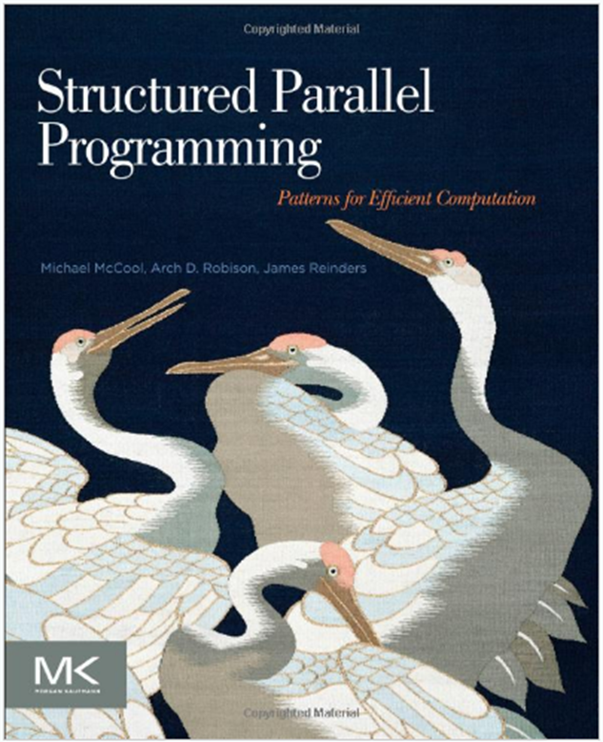
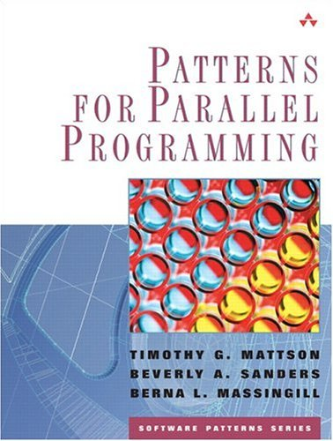
Background references
A great book that explores key patterns with Cilk, TBB, OpenCL, and OpenMP (by McCool, Robison, and Reinders)
A book about how to “think parallel” with examples in OpenMP, MPI and java

Slide 112
Outline
Introduction to OpenMP
Creating Threads
Synchronization
Parallel Loops
Data Environment
Memory Model
Irregular Parallelism and Tasks
Recap
Beyond the Common Core:
Worksharing Revisited
Synchronization Revisited: Options for Mutual exclusion
Thread Affinity and Data Locality
Thread Private Data
Memory models and point-to-point Synchronization
Programming your GPU with OpenMP

Slide 113
The Loop Worksharing Constructs
The loop worksharing construct splits up loop iterations among the threads in a team
#pragma omp parallel
{ #pragma omp for for (I=0;I<N;I++){ NEAT_STUFF(I); } }
Loop construct name:
C/C++: for
Fortran: do
The variable I is made “private” to each thread by default. You could do this explicitly with a “private(I)” clause

Slide 114
Loop Worksharing Constructs: The schedule clause
The schedule clause affects how loop iterations are mapped onto threads
schedule(static [,chunk])
Deal-out blocks of iterations of size “chunk” to each thread.
schedule(dynamic[,chunk])
Each thread grabs “chunk” iterations off a queue until all iterations have been handled.
schedule(guided[,chunk])
Threads dynamically grab blocks of iterations. The size of the block starts large and shrinks down to size “chunk” as the calculation proceeds.
schedule(runtime)
Schedule and chunk size taken from the OMP_SCHEDULE environment variable (or the runtime library) … vary schedule without a recompile!
Schedule(auto)
Schedule is left up to the runtime to choose (does not have to be any of the above).
OpenMP 4.5 added modifiers monotonic, nonmontonic and simd.
Notes:
Example:
#pragma omp for schedule (monotonic:stack,10)
Monotonic …. Split iterations into chunks, threads to their assigned chunks in logical iteration order.
Nonmonotonic ... Chunks assigned in any order and an application that depends on order chunks are exectued is in error. Nonmonotonic only applies to dynamic of guided.
SIMD ... Only has impact if the loop is associated wiht a simd construct. Means the chunk size for all chuns other than the firat and last is
size = (chunks/simd_width) * simd_witch

Slide 115
Loop Worksharing Constructs: The schedule clause
Schedule Clause | When To Use
STATIC | Pre-determined and predictable by the programmer
DYNAMIC | Unpredictable, highly variable work per iteration
GUIDED | Special case of dynamic to reduce scheduling overhead
AUTO | When the runtime can “learn” from previous executions of the same loop
Least work at runtime : scheduling done at compile-time
Most work at runtime : complex scheduling logic used at run-time
Notes:
First off, I would add "static,1" to table. In my experience, many users expect that "static" will make each thread get at least 1 iteration if you have p threads and >p iterations. This guarantee is only present for "static,1" and we should add that here. "static" tries to divide the work evenly, but does not guarantee that each thread will get something. Most static scheduling algorithms use the formula (n+p)/p for each thread, remainder for 1 thread, and 0 for remaining thread.
Also, I think adding "pre-determined" to the static descriptions is important.

Slide 116
Nested Loops
For perfectly nested rectangular loops we can parallelize multiple loops in the nest with the collapse clause:
#pragma omp parallel for collapse(2)
for (int i=0; i<N; i++) {
for (int j=0; j<M; j++) {
.....
}
}
Number of loops to be parallelized, counting from the outside
Will form a single loop of length NxM and then parallelize that.
Useful if N is O(no. of threads) so parallelizing the outer loop makes balancing the load difficult.
116

Slide 117
Sections Worksharing Construct
The Sections worksharing construct gives a different structured block to each thread.
#pragma omp parallel {
#pragma omp sections { #pragma omp section x_calculation(); #pragma omp section y_calculation(); #pragma omp section z_calculation(); }
}
By default, there is a barrier at the end of the “omp sections”. Use the “nowait” clause to turn off the barrier.

Slide 118
Array Sections with Reduce
#include <stdio.h>
#define N 100
void init(int n, float (*b)[N]);
int main(){
int i,j; float a[N], b[N][N]; init(N,b);
for(i=0; i<N; i++) a[i]=0.0e0;
#pragma omp parallel for reduction(+:a[0:N]) private(j)
for(i=0; i<N; i++){
for(j=0; j<N; j++){
a[j] += b[i][j];
}
}
printf(" a[0] a[N-1]: %f %f\n", a[0], a[N-1]);
return 0;
Works the same as any other reduce … a private array is formed for each thread, element wise combination across threads and then with original array at the end

Slide 119
Exercise
Go back to your parallel mandel.c program.
Using what we’ve learned in this block of slides can you improve the runtime?

Slide 120
Optimizing mandel.c
wtime = omp_get_wtime(); #pragma omp parallel for collapse(2) schedule(runtime) firstprivate(eps) private(j,c)
for (i=0; i<NPOINTS; i++) {
for (j=0; j<NPOINTS; j++) {
c.r = -2.0+2.5*(double)(i)/(double)(NPOINTS)+eps;
c.i = 1.125*(double)(j)/(double)(NPOINTS)+eps;
testpoint(c);
}
}
wtime = omp_get_wtime() - wtime;
$ export OMP_SCHEDULE=“dynamic,100”
$ ./mandel_par
default schedule | 0.48 secs
schedule(dynamic,100) | 0.39 secs
collapse(2) schedule(dynamic,100) | 0.34 secs
Four threads on a dual core Apple laptop (Macbook air … 2.2 Ghz Intel Core i7 with 8 GB memory) and the gcc version 9.1. Times are the minimum time from three runs

Slide 121
Outline
Introduction to OpenMP
Creating Threads
Synchronization
Parallel Loops
Data Environment
Memory Model
Irregular Parallelism and Tasks
Recap
Beyond the Common Core:
Worksharing Revisited
Synchronization Revisited: Options for Mutual exclusion
Thread Affinity and Data Locality
Thread Private Data
Memory models and point-to-point Synchronization
Programming your GPU with OpenMP

Slide 122
Synchronization
Synchronization is used to impose order constraints between threads and to protect access to shared data
High level synchronization included in the common core:
critical
barrier
Other, more advanced, synchronization operations:
atomic
ordered
flush
locks (both simple and nested)
Covered earlier
Covered in this section

Slide 123
Synchronization: Atomic
Atomic provides mutual exclusion but only applies to the update of a memory location (the update of X in the following example)
#pragma omp parallel
{ double tmp, B;
B = DOIT();
#pragma omp atomic X += big_ugly(B);
}
#pragma omp parallel
{ double B;
B = DOIT();
#pragma omp atomic X += big_ugly(B);
}

Slide 124
Synchronization: Atomic
Atomic provides mutual exclusion but only applies to the update of a memory location (the update of X in the following example)
#pragma omp parallel
{ double B, tmp;
B = DOIT();
tmp = big_ugly(B);
#pragma omp atomic X += tmp;
}
Atomic only protects the read/update of X

Slide 125
The OpenMP 3.1 Atomics (1 of 2)
Atomic was expanded to cover the full range of common scenarios where you need to protect a memory operation so it occurs atomically:
# pragma omp atomic [read | write | update | capture]
Atomic can protect loads
# pragma omp atomic read
v = x;
Atomic can protect stores
# pragma omp atomic write
x = expr;
Atomic can protect updates to a storage location (this is the default behavior … i.e. when you don’t provide a clause)
# pragma omp atomic update
x++; or ++x; or x--; or –x; or
x binop= expr; or x = x binop expr;
This is the original OpenMP atomic

Slide 126
The OpenMP 3.1 Atomics (2 of 2)
Atomic can protect the assignment of a value (its capture) AND an associated update operation:
# pragma omp atomic capture
statement or structured block
Where the statement is one of the following forms:
v = x++; v = ++x; v = x--; v = –x; v = x binop expr;
Where the structured block is one of the following forms:
{v = x; x binop = expr;} | {x binop = expr; v = x;}
{v=x; x=x binop expr;} | {X = x binop expr; v = x;}
{v = x; x++;} | {v=x; ++x:}
{++x; v=x:} | {x++; v = x;}
{v = x; x--;} | {v= x; --x;}
{--x; v = x;} | {x--; v = x;}
The capture semantics in atomic were added to map onto common hardware supported atomic operations and to support modern lock free algorithms

Slide 127
Synchronization: Lock Routines
A lock implies a memory fence (a “flush”) of all thread visible variables
Simple Lock routines:
A simple lock is available if it is unset.
omp_init_lock(), omp_set_lock(), omp_unset_lock(), omp_test_lock(), omp_destroy_lock()
Nested Locks
A nested lock is available if it is unset or if it is set but owned by the thread executing the nested lock function
omp_init_nest_lock(), omp_set_nest_lock(), omp_unset_nest_lock(), omp_test_nest_lock(), omp_destroy_nest_lock()
Note: a thread always accesses the most recent copy of the lock, so you don’t need to use a flush on the lock variable.
Locks with hints were added in OpenMP 4.5 to suggest a lock strategy based on intended use (e.g. contended, uncontended, speculative, unspeculative)

Slide 128
Synchronization: Simple Locks Example
Count odds and evens in an input array(x) of N random values.
int i, ix, even_count = 0, odd_count = 0;
omp_lock_t odd_lck, even_lck;
omp_init_lock(&odd_lck);
omp_init_lock(&even_lck);
#pragma omp parallel for private(ix) shared(even_count, odd_count)
for(i=0; i<N; i++){
ix = (int) x[i]; //truncate to int
if(((int) x[i])%2 == 0) {
omp_set_lock(&even_lck);
even_count++;
omp_unset_lock(&even_lck);
}
else{
omp_set_lock(&odd_lck);
odd_count++;
omp_unset_lock(&odd_lck);
}
} omp_destroy_lock(&odd_lck);
omp_destroy_lock(&even_lck);
}
One lock per case … even and odd
Enforce mutual exclusion updates, but in parallel for each case.
Free-up storage when done.
Notes:
I need a better example. I want it this short, but it would be nice if the locks allowed me to do something I couldn’t do with a critical.

Slide 129
Exercise
In the file hist.c, we provide a program that generates a large array of random numbers and then generates a histogram of values.
This is a ”quick and informal” way to test a random number generator … if all goes well the bins of the histogram should be the same size.
Parallelize the filling of the histogram You must assure that your program is race free and gets the same result as the sequential program.
Using everything we’ve covered today, manage updates to shared data in two different ways. Try to minimize the time to generate the histogram.
Time ONLY the assignment to the histogram. Can you beat the sequential time?

Slide 130
Histogram Program: Critical section
A critical section means that only one thread at a time can update a histogram bin … but this effectively serializes the loops and adds huge overhead as the runtime manages all the threads waiting for their turn for the update.
#pragma omp parallel for
for(i=0;i<NVALS;i++){
ival = (int) x[i];
#pragma omp critical
hist[ival]++;
}
Easy to write and correct, but terrible performance
Notes:
I need a better example. I want it this short, but it would be nice if the locks allowed me to do something I couldn’t do with a critical.

Slide 131
Histogram program: one lock per histogram bin
Example: conflicts are rare, but to play it safe, we must assure mutual exclusion for updates to histogram elements.
#pragma omp parallel for
for(i=0;i<NBUCKETS; i++){
omp_init_lock(&hist_locks[i]); hist[i] = 0;
}
#pragma omp parallel for
for(i=0;i<NVALS;i++){
ival = (int) x[i];
omp_set_lock(&hist_locks[ival]);
hist[ival]++;
omp_unset_lock(&hist_locks[ival]);
}
#pragma omp parallel for
for(i=0;i<NBUCKETS; i++)
omp_destroy_lock(&hist_locks[i]);
One lock per element of hist
Enforce mutual exclusion on update to hist array
Free-up storage when done.
Notes:
I need a better example. I want it this short, but it would be nice if the locks allowed me to do something I couldn’t do with a critical.

Slide 132
Histogram program: reduction with an array
We can give each thread a copy of the histogram, they can fill them in parallel, and then combine them when done
#pragma omp parallel for reduction(+:hist[0:Nbins])
for(i=0;i<NVALS;i++){
ival = (int) x[i];
hist[ival]++;
}
Easy to write and correct, Uses a lot of memory on the stack, but its fast … sometimes faster than the serial method.
sequential | 0.0019 secs
critical | 0.079 secs
Locks per bin | 0.029 secs
Reduction, replicated histogram array | 0.00097 secs
1000000 random values in X sorted into 50 bins. Four threads on a dual core Apple laptop (Macbook air … 2.2 Ghz Intel Core i7 with 8 GB memory) and the gcc version 9.1. Times are for the above loop only (we do not time set-up for locks, destruction of locks or anything else)
Notes:
$ ./hist_par
4 threads
Sequential histogram for 50 buckets of 1000000 values
ave = 20000.000000, std_dev = 394.372925
in 0.001911 seconds
par with critical histogram for 50 buckets of 1000000 values
ave = 20000.000000, std_dev = 394.372925
in 0.079093 seconds
par with locks histogram for 50 buckets of 1000000 values
ave = 20000.000000, std_dev = 394.372925
in 0.029444 seconds
par with reduction histogram for 50 buckets of 1000000 values
ave = 20000.000000, std_dev = 394.372925
in 0.000972 seconds

Slide 133
Sometimes when working with multiple interacting locks, you have to pay attention to the locking orders Lock Example from Gafort (SpecOMP’2001)
Genetic algorithm in Fortran
Most “interesting” loop: shuffle the population.
Original loop is not parallel; performs pair-wise swap of an array element with another, randomly selected element. There are 40,000 elements.
Parallelization idea:
Perform the swaps in parallel
Need to prevent simultaneous access to same array element: use one lock per array element → 40,000 locks.

Slide 134
!$OMP PARALLEL PRIVATE(rand, iother, itemp, temp, my_cpu_id) my_cpu_id = 1 !$ my_cpu_id = omp_get_thread_num() + 1 !$OMP DO DO j=1,npopsiz-1 CALL ran3(1,rand,my_cpu_id,0) iother=j+1+DINT(DBLE(npopsiz-j)*rand) !$ IF (j < iother) THEN !$ CALL omp_set_lock(lck(j)) !$ CALL omp_set_lock(lck(iother)) !$ ELSE !$ CALL omp_set_lock(lck(iother)) !$ CALL omp_set_lock(lck(j)) !$ END IF itemp(1:nchrome)=iparent(1:nchrome,iother) iparent(1:nchrome,iother)=iparent(1:nchrome,j) iparent(1:nchrome,j)=itemp(1:nchrome) temp=fitness(iother) fitness(iother)=fitness(j) fitness(j)=temp !$ IF (j < iother) THEN !$ CALL omp_unset_lock(lck(iother)) !$ CALL omp_unset_lock(lck(j)) !$ ELSE !$ CALL omp_unset_lock(lck(j)) !$ CALL omp_unset_lock(lck(iother)) !$ END IF END DO !$OMP END DO !$OMP END PARALLEL
Parallel Loop
In shuffle.f
of Gafort
Exclusive access to array elements.
Ordered locking prevents deadlock.
Notes:
Font too small

Slide 135
Outline
Introduction to OpenMP
Creating Threads
Synchronization
Parallel Loops
Data Environment
Memory Model
Irregular Parallelism and Tasks
Recap
Beyond the Common Core:
Worksharing Revisited
Synchronization Revisited: Options for Mutual exclusion
Thread Affinity and Data Locality
Thread Private Data
Memory models and point-to-point Synchronization
Programming your GPU with OpenMP

Slide 136
OpenMP basic definitions: Basic Solution stack
In learning OpenMP, you consider a Symmetric Multiprocessor (SMP) ….
i.e. lots of threads with “equal cost access” to memory

Slide 137
CPU Architecture Trend
Multi-socket nodes with rapidly increasing core counts
Memory per core decreases
Memory bandwidth per core decreases
Network bandwidth per core decreases
Applications often use a hybrid programming model with three levels of parallelism
MPI between nodes or sockets
Shared memory (such as OpenMP) on the nodes/sockets
Increase vectorization for lower level loop structures

Slide 138
A Typical CPU Node in an HPC System 2 Intel® Xeon™ E5-2698 v3 CPUs (Haswell) per node (launched Q3’14)
2 Hardware threads per core
Intel® AVX2 (256 bit Vector unit)
L1$ instruction and data: 32 KB
Unified L2$ 256 KB
40 MB shared L3$
As configured for Cori at NERSC: CPUs at 2.3 GHz, 2 16 GB DIMMs per DDR memory controller, 16 cores per CPU. 2 CPUs connected by a high-speed interconnect (QPI)
Notes:
Each node has two sockets, each socket is populated with a 2.3 GHz 16-core Haswell processor. Intel Xeon Processor E5-2698 v3.
Each core supports 2 hyper-threads, and has two 256-bit-wide vector units
36.8 Gflops/core (theoretical peak)
1.2 TFlops/node (theoretical peak)
2.81 PFlops total (theoretical peak)
Each node has 128 GB DDR4 2133 MHz memory (four 16 GB DIMMs per socket)
298.5 TB total aggregate memory

Slide 139
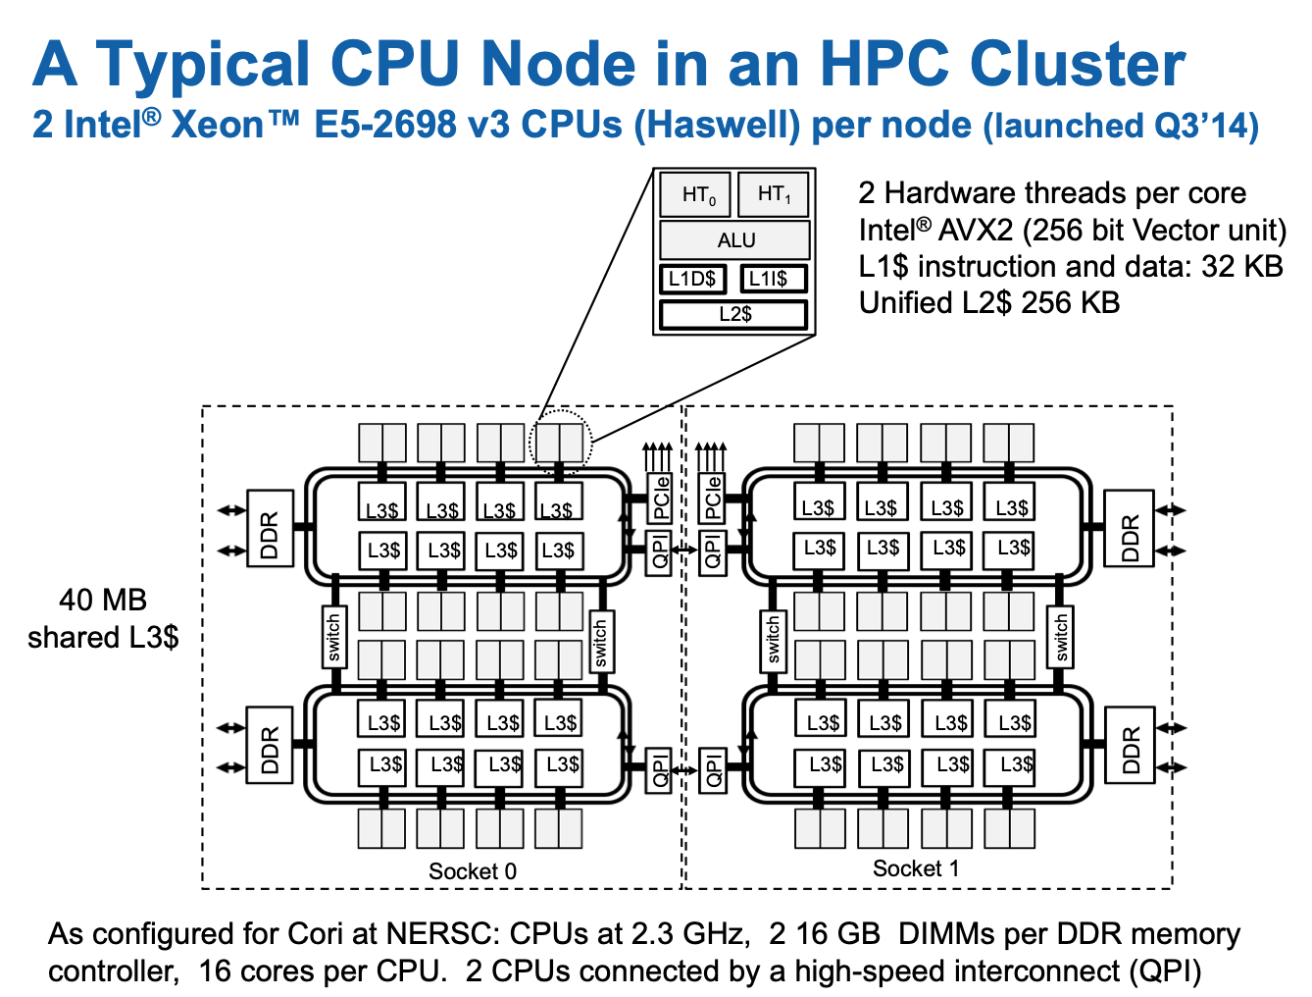
Does this look like an SMP node to you?
There may be a single address space, but there are multiple levels of non-uniformity to the memory. This is a Non-Uniform Memory Architecture (NUMA)
Even a single CPU is properly considered a NUMA architecture
Notes:
Each node has two sockets, each socket is populated with a 2.3 GHz 16-core Haswell processor. Intel Xeon Processor E5-2698 v3.
Each core supports 2 hyper-threads, and has two 256-bit-wide vector units
36.8 Gflops/core (theoretical peak)
1.2 TFlops/node (theoretical peak)
2.81 PFlops total (theoretical peak)
Each node has 128 GB DDR4 2133 MHz memory (four 16 GB DIMMs per socket)
298.5 TB total aggregate memory

Slide 140
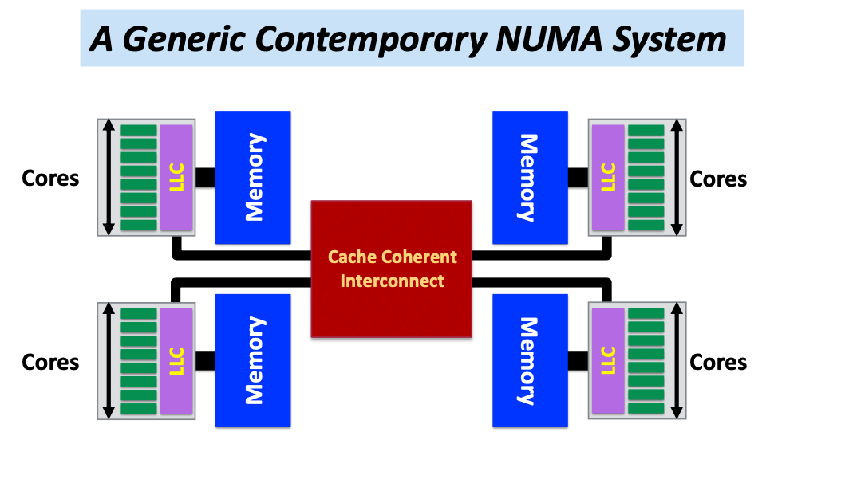
NUMA Systems
Most systems today are Non-Uniform Memory Access (NUMA)
Accessing memory in remote NUMA is slower than accessing memory in local NUMA
Accessing High Bandwidth Memory is faster than DDR
Each core may have multiple hyperthreads
Also possible on-package high bandwidth memory on the node
Diagram courtesy Ruud van der Pas

Slide 141

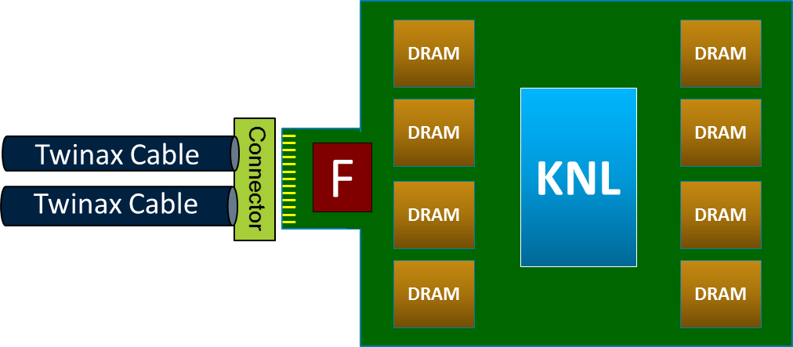
Memory Locality
Most systems today are Non-Uniform Memory Access (NUMA)
Example, the Intel® Xeon Phi™ processor
Over 6 TF SP peak
Full Xeon ISA compatibility through AVX-512
Up to 16GB high-bandwidth on-package memory (MCDRAM)
Exposed as NUMA node
>400 GB/s sustained BW
2x 512b VPU per core (Vector Processing Units)
Up to 72 cores (36 tiles)
2D mesh architecture
Tile
MCDRAM
MCDRAM
MCDRAM
MCDRAM
2 VPU
HUB
2 VPU
6 channels DDR4
Up to 384GB
~90 GB/s
DDR4
DDR4
Core
1MB L2
Core
Up to 72 cores
DDR4
DDR4
DDR4
DDR4
MCDRAM
MCDRAM
MCDRAM
MCDRAM
Based on Intel® Atom™ processor with many HPC enhancements
Deep out-of-order buffers
Gather/scatter in hardware
Improved branch prediction
4 threads/core
High cache bandwidth
HFI
On-package
2 ports OPA Integrated Fabric
PCIe Gen3
x36
Micro-Coax Cable (IFP)
Micro-Coax Cable (IFP)
Diagram is for conceptual purposes only and only illustrates a CPU and memory – it is not to scale and does not include all functional areas of the CPU, nor does it represent actual component layout.

Slide 142
Memory Locality
Memory access in different NUMA domains are different
Accessing memory in remote NUMA is slower than accessing memory in local NUMA
Accessing High Bandwidth Memory on KNL* is faster than DDR
OpenMP does not explicitly map data across shared memories
Memory locality is important since it impacts both memory and intra-node performance
*KNL: Intel® Xeon Phi™ processor 7250 with 68 cores @ 1.4 Ghz … the “bootable” version that sits in a socket, not a co-processor

Slide 143
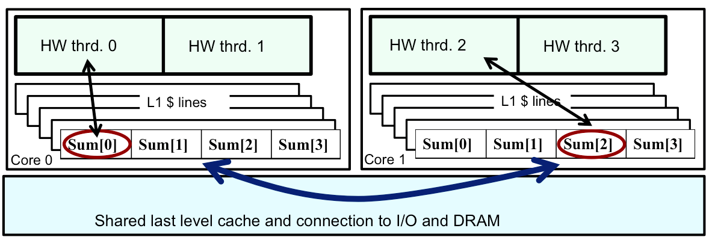
Cache Coherence and False Sharing
ccNUMA node: cache-coherence NUMA node.
Data from memory are accessed via cache lines.
Multiple threads hold local copies of the same (global) data in their caches. Cache coherence ensures the local copy to be consistent with the global data.
Main copy needs to be updated when a thread writes to local copy.
Writes to same cache line from different threads is called false sharing or cache thrashing, since it needs to be done in serial. Use atomic or critical or private variables to avoid race condition.

Slide 144
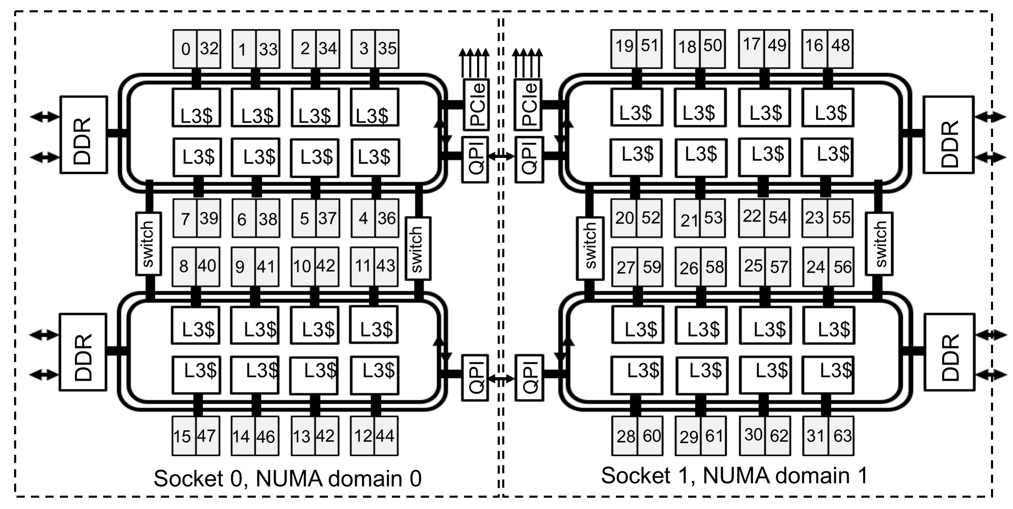
Exploring your NUMA world: NUMACTL
numactl shows you how the OS processor-numbers map onto the physical cores of the chip:
2 Intel® Xeon™ E5-2698 v3 CPUs (Haswell) per node (launched Q3’14)

Slide 145
Tool to Check NUMA Node Information: numactl
numactl: controls NUMA policy for processes or shared memory
numactl -H: provides NUMA info of the CPUs
Haswell node example
32 cores, 2 sockets
% numactl -H
available: 2 nodes (0-1)
node 0 cpus: 0 1 2 3 4 5 6 7 8 9 10 11 12 13 14 15 32 33 34 35 36 37 38 39 40 41 42 43 44 45 46 47
node 0 size: 64430 MB
node 0 free: 63002 MB
node 1 cpus: 16 17 18 19 20 21 22 23 24 25 26 27 28 29 30 31 48 49 50 51 52 53 54 55 56 57 58 59 60 61 62 63
node 1 size: 64635 MB
node 1 free: 63395 MB
node distances:
node 0 1
0: 10 21
1: 21 10
Shows relative costs …. In this case, there’s a factor of two in the cost of the local (on CPU) DRAM vs going to the other socket
*Haswell: 16-core Intel® Xeon™ Processor E5-2698 v3 at 2.3 GHz

Slide 146
Use numactl Command Line Tool
numactl is a Linux tool to investigate and handle NUMA
Can be used to request CPU or memory binding
Use “numactl <options> ./myapp” as the executable (instead of “./myapp”)
CPU binding example:
% numactl --cpunodebind 0,1 ./code.exe
only use cores of NUMA nodes 0 and 1
Memory binding example:
% numactl --membind 1 ./code.exe
only use memory in NUMA nodes 1, such as the MCDRAM (High Bandwidth Memory) in KNL quad, flat mode

Slide 147
Tools to Check Node Information: hwloc
Portable Hardware Locality (hwloc)
hwloc-ls and lstopo: provides a text and graphical representation of the system topology, NUMA nodes, cache info, and the mapping of procs.
Haswell node example
32 cores, 2 sockets

Slide 148
Haswell Compute Nodes Example
To obtain processor info:
Get on a compute node:
% salloc -N 1 -C …
Then:
% numactl -H
or % cat /proc/cpuinfo
or % hwloc-ls
Each Haswell node has 2 Intel Xeon 16-core Haswell processors
2 NUMA domains (sockets) per node, 16 cores per NUMA domain. 2 hardware threads per physical core.
NUMA Domain 0: physical cores 0-15 (and logical cores 32-47) NUMA Domain 1: physical cores 16-31 (and logical cores 48-63)
Memory bandwidth is non-homogeneous among NUMA domains

Slide 149
Find Processor Info on a Mac Laptop
$ sysctl -n machdep.cpu.brand_string
Intel(R) Core(TM) i7-8569U CPU @ 2.80GHz
$ system_profiler |grep Processor
…
Processor Name: Quad-Core Intel Core i7
Processor Speed: 2.8 GHz
Number of Processors: 1
…

Slide 150
Exercise: Node Information
Characterize the processor/memory layout of your system
Try on a Cori login node, a Cori Haswell and a Cori KNL node, and find out the differences

Slide 151
Process / Thread / Memory Affinity (1)
Process Affinity: also called "CPU pinning", binds processes (MPI tasks, etc.) to a CPU or a range of CPUs on a node
It is important to spread MPI ranks evenly onto cores in different NUMA domains
Thread Affinity: further binding threads to CPUs that are allocated to their parent process
Thread affinity should be based on achieving process affinity first
Threads forked by a certain MPI task have thread affinity binding close to the process affinity binding of their parent MPI task
Do not over schedule CPUs for threads

Slide 152
Process / Thread / Memory Affinity (2)
Memory Locality: allocate memory as close as possible to the core on which the task that requested the memory is running
Applications should use memory from local NUMA domain as much as possible
Cache Locality: reuse data in cache as much as possible
Our goal is to promote OpenMP standard settings for portability
OMP_PLACES and OMP_PROC_BIND are preferred to vendor specific settings
Correct process, thread and memory affinity is the basis for getting optimal performance. It is also essential for guiding further performance optimizations.

Slide 153
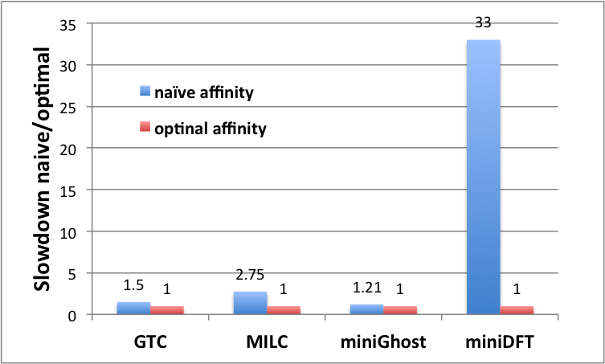
Naïve vs. Optimal Affinity
Application Benchmark Performance on Cori

Slide 154
OpenMP Thread Affinity
Three main concepts:
Hardware
Abstraction
Mapping Strategy
OpenMP
Threads
OMP_PROC_BIND
Environment Variable
or
proc_bind() clause
of parallel region
OMP_NUM_THREADS
Environment Variable
or
num_threads() clause
of parallel region
OMP_PLACES
Environment Variable
(e.g. threads, cores, sockets)
Courtesy of Oscar Hernandez, ORNL

Slide 155
Writing NUMA-aware OpenMP Code
Control the places where threads are mapped
Place threads onto cores to optimize performance
Keep threads working on similar data close to each other
Maximize utilization of memory controllers by spreading threads out
Processor binding … Disable thread migration
By Default, an OS migrates threads to maximize utilization of resources on the chip.
To Optimize for NUMA, we need to turn off thread migration … bind threads to a processor/core
Memory Affinity
Maximize reuse of data in the cache hierarchy
Maximize reuse of data in memory pages

Slide 156
The Concept of Places
The Operating System assigns logical CPU IDs to hardware threads.
Recall … the linux command numactl –H returns those numbers.
A place: numbers between { }:
export OMP_PLACES=“{0,1,2,3}”
A place defines where threads can run
> export OMP_PLACES “{0, 3, 15, 12, 19, 16, 28, 31}”
> export NUM_THREADS= 6
#pragma omp parallel
{
// do a bunch of cool stuff
}

Slide 157
The Concept of Places
The Operating System assigns logical CPU IDs to hardware threads.
Recall … the linux command numactl –H returns those numbers.
Set with an environment variable:
export OMP_PLACES=“{0,1,2,3}”
Can also specify with {lower-bound:length:stride}
OMP_PLACES=“{0,1,2,3}” → OMP_PLACES=“{0:4:1}” → OMP_PACES=“{0:4}”
Can define multiple places:
OMP_PLACES=“{0,1,2,3},{4,6,8},{9,10,11,12}”
OMP_PLACES=“{0,4},{4,3:2},{9:4}”
Default Stride is 1
These are equivalent

Slide 158
The Concept of Places
The Operating System assigns logical CPU IDs to hardware threads.
Recall … the linux command numactl –H returns those numbers.
Set with an environment variable:
export OMP_PLACES=“{0,1,2,3}”
Can also specify with {lower-bound:length:stride}
OMP_PLACES=“{0,1,2,3}” → OMP_PLACES=“{0:4:1}” → OMP_PACES=“{0:4}”
Can define multiple places:
OMP_PLACES=“{0,1,2,3},{4,6,8},{9,10,11,12}”
OMP_PLACES=“{0,4},{4,3:2},{9:4}”
Programmers can use OMP_PLACES for detailed control over the execution-units threads utilize. BUT …
The rules for mapping onto physical execution units are complicated.
PLACES expressed as numbers is non-portable
There has to be an easier and more portable way to describe places
Default Stride is 1
These are equivalent

Slide 159
Hardware Abstraction: OMP_PLACES
OMP_PLACES environment variable
controls thread allocation
defines a series of places to which the threads are assigned
It can be an abstract name or a specific list
threads: each place corresponds to a single hardware thread
cores: each place corresponds to a single core (having one or more hardware threads)
sockets: each place corresponds to a single socket (consisting of one or more cores)
a list with explicit place values of CPU ids, such as:
export OMP_PLACES=“ {0:4:2},{1:4:2}” (equivalent to “{0,2,4,6},{1,3,5,7}”)
Examples:
export OMP_PLACES=threads
export OMP_PLACES=cores

Slide 160
Writing NUMA-aware OpenMP Code
Control the places where threads are mapped
Place threads onto cores to optimize performance
Keep threads working on similar data close to each other
Maximize utilization of memory controllers by spreading threads out
Processor binding … Disable thread migration
By Default, an OS migrates threads to maximize utilization of resources on the chip.
To Optimize for NUMA, we need to turn off thread migration … bind threads to a processor/core
Memory Affinity
Maximize reuse of data in the cache hierarchy
Maximize reuse of data in memory pages

Slide 161
Mapping Strategy: OMP_PROC_BIND (1)
Controls thread affinity within and between OpenMP places
Allowed values:
true: the runtime will not move threads around between processors
false: the runtime may move threads around between processors
close: bind threads close to the master thread
spread: bind threads as evenly distributed (spreaded) as possible
primary*: bind threads to the same place as the master thread
The values primary*, close, and spread imply the value true
Examples:
export OMP_PROC_BIND=spread
export OMP_PROC_BIND=spread,close (for nested levels)
*the term “master” has been deprecated in OpenMP 5.1 and replaced with the term “primary”.

Slide 162
Mapping Strategy: OMP_PROC_BIND (2)
Put threads far apart (spread) may improve aggregated memory bandwidth and available cache size for your application, but may also increase synchronization overhead
Put threads “close” have the reverse impact as “spread”

Slide 163
Mapping Strategy: OMP_PROC_BIND (2)
Prototype example: 4 cores total, 2 hyperthreads per core, 4 OpenMP threads
none: no affinity setting
close: Bind threads as close to each other as possible
spread: Bind threads as far apart as possible
master: bind threads to the same place as the master thread
Node | Core 0 |  | Core 1 |  | Core 2 |  | Core 3
 | HT1 | HT2 | HT1 | HT2 | HT1 | HT2 | HT1 | HT2
Thread | 0 | 1 | 2 | 3
Node | Core 0 |  | Core 1 |  | Core 2 |  | Core 3
 | HT1 | HT2 | HT1 | HT2 | HT1 | HT2 | HT1 | HT2
Thread | 0 |  | 1 |  | 2 |  | 3

Slide 164
Various Methods to Set Number of Threads
1) Use num_threads clause #pragma omp parallel num_threads (4) {
int ID = omp_get_thread_num(); pooh(ID,A); }
3) Set runtime environment
export OMP_NUM_THREDS=4 #pragma omp parallel { int ID = omp_get_thread_num(); pooh(ID,A); }
2) Call omp_set_num_threads API omp_set_num_threads(4); #pragma omp parallel { int ID = omp_get_thread_num(); pooh(ID,A); }
4) Do none of the three above.
Code will use an implementation
dependent default number of threads
defined by the compiler.
Precedence: 1) > 2) > 3) > 4)
You may get fewer threads than you requested, check with omp_get_num_threads()

Slide 165
Affinity Clauses for OpenMP Parallel Construct
The num_threads and proc_bind clauses can be used
The values set with these clauses take precedence over values set by runtime environment variables
Helps code portability
Examples:
C/C++:
#pragma omp parallel num_threads(2) proc_bind(spread)
Fortran:
!$omp parallel num_threads (2) proc_bind (spread)
…
!$omp end parallel

Slide 166
Affinity Verification Methods
NERSC provides pre-built binaries from a Cray code (xthi.c) to display process thread affinity
% srun -n 32 -c 8 --cpu-bind=cores check-mpi.intel.cori | sort -nk 4
Hello from rank 0, on nid02305. (core affinity = 0,1,68,69,136,137,204,205)
Hello from rank 1, on nid02305. (core affinity = 2,3,70,71,138,139,206,207)
Use portable OpenMP environment variables OMP_DISPLAY_AFFINITY and OMP_AFFINITY_FORMAT (in OpenMP 5.0)
Automatically displays affinity info when OMP_DISPLAY_AFFINITY=true
Can set custom OMP_DISPLAY_AFFINITY_FORMAT
Also has runtime APIs such as omp_display_affinity and omp_capture_affinity

Slide 167
OMP_AFFINITY_FORMAT Fields
Short Name | Long name | Meaning
L | thread_level | from omp_get_level()
n | thread_num | from omp_get_thread_num()
a | thread_affinity | the numerical identifiers of the processors the current thread is binding to, in the format of a comma separated list of OpenMP thread places
h | host | host or node name
p | process_id | process id used by the implementation (such as the process id for the MPI process)
N | num_threads | from omp_get_num_threads()
A | ancestor_tnum | from omp_get_ancestor_thread_num(). One level up only.
% export OMP_DISPLAY_AFFINITY=true
% export OMP_AFFINITY_FORMAT="host=%h, pid=%p, thread_num=%n, thread affinity=%a”
host=nid02496, pid=150147, thread_num=0, thread affinity=0
host=nid02496, pid=150147, thread_num=1, thread affinity=4
% export OMP_AFFINITY_FORMAT="Thread Affinity: %0.3L %.10n %.20{thread_affinity} %.15h”
Thread Affinity: 001 0 0-1,16-17 nid003
Thread Affinity: 001 1 2-3,18-19 nid003

Slide 168
Sample Nested OpenMP Program
#include <omp.h>
#include <stdio.h>
void report_num_threads(int level)
{
#pragma omp single {
printf("Level %d: number of threads in the team: %d\n", level, omp_get_num_threads());
}
}
int main()
{
omp_set_dynamic(0);
#pragma omp parallel num_threads(2) {
report_num_threads(1);
#pragma omp parallel num_threads(2) {
report_num_threads(2);
#pragma omp parallel num_threads(2) {
report_num_threads(3);
}
}
}
return(0);
}
% ./a.out
Level 1: number of threads in the team: 2
Level 2: number of threads in the team: 1
Level 3: number of threads in the team: 1
Level 2: number of threads in the team: 1
Level 3: number of threads in the team: 1
% export OMP_NESTED=true
% export OMP_MAX_ACTIVE_LEVELS=3
% ./a.out
Level 1: number of threads in the team: 2
Level 2: number of threads in the team: 2
Level 2: number of threads in the team: 2
Level 3: number of threads in the team: 2
Level 3: number of threads in the team: 2
Level 3: number of threads in the team: 2
Level 3: number of threads in the team: 2
Level 0: P0
Level 1: P0 P1
Level 2: P0 P2; P1 P3
Level 3: P0 P4; P2 P5; P1 P6; P3 P7

Slide 169
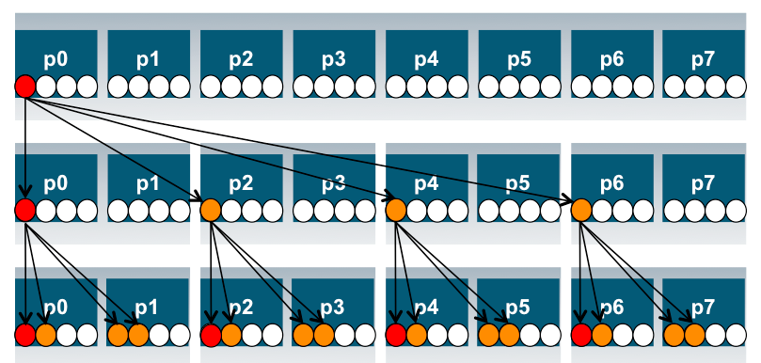
Process and Thread Affinity in Nested OpenMP
A combination of OpenMP environment variables and runtime flags are needed for different compilers and different batch schedulers on different systems
Use num_threads clause in source codes to set threads for nested regions
For most other non-nested regions, use OMP_NUM_THREADS environment variable for simplicity and flexibility
#pragma omp parallel proc_bind(spread)
#pragma omp parallel proc_bind(close)
Illustration of a system with:
2 sockets, 4 cores per socket,
4 hyper-threads per core
Example: Use Intel compiler with SLURM on Cori Haswell:
export OMP_NESTED=true
export OMP_MAX_ACTIVE_LEVELS=2
export OMP_NUM_THREADS=4,4
export OMP_PROC_BIND=spread,close
export OMP_PLACES=threads
srun -n 4 -c 16 --cpu_bind=cores ./code.exe
initial
spread
close

Slide 170
When to Use Nested OpenMP
Beneficial to use nested OpenMP to allow more fine-grained thread parallelism
Some application teams are exploring with nested OpenMP to allow more fine-grained thread parallelism
Hybrid MPI/OpenMP not using node fully packed
Top level OpenMP loop does not use all available threads
Multiple levels of OpenMP loops are not easily collapsed
Certain computational intensive kernels could use more threads
MKL can use extra cores with nested OpenMP
Nested level can be arbitrarily deep

Slide 171
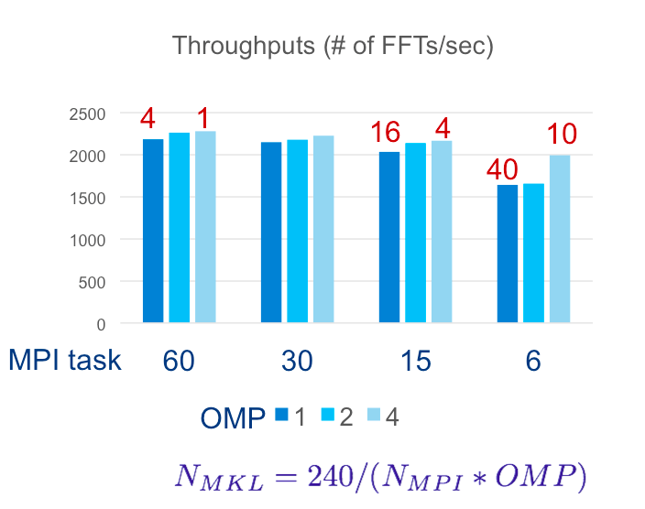
Use Multiple Threads in MKL
By Default, in OpenMP parallel regions, only 1 thread will be used for MKL calls.
MKL_DYNAMICS is true by default
Nested OpenMP can be used to enable multiple threads for MKL calls. Treat MKL as a nested inner OpenMP region.
Sample settings
export OMP_NESTED=true
export OMP_PLACES=cores
export OMP_PROC_BIND=sprad,close
export OMP_NUM_THREADS=6,4
export MKL_DYNAMICS=false
export OMP_MAX_ACTIVE_LEVELS=2
FFT3D on KNC, Ng=64³ example
Courtesy of Jeongnim Kim, Intel
*KNC: Intel® Xeon Phi™ processor (Knights Corner) … the first generation co-processor version of the chip.

Slide 172
Exercise: Affinity Verification
Run the “Hello World” code, use OMP_DISPLAY_AFFINITY to observe affinity status
Change thread binding and number of threads and see how affinity status changes

Slide 173
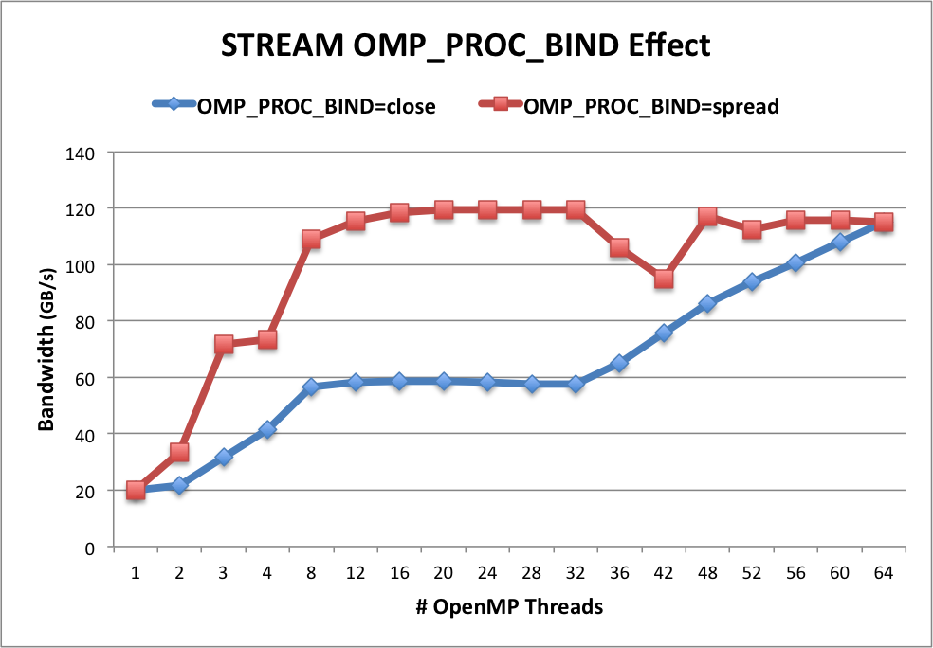
OMP_PROC_BIND Choices for STREAM Benchmark
OMP_NUM_THREADS=32
OMP_PLACES=threads
OMP_PROC_BIND=close
Threads 0 to 31 bind to CPUs 0,32,1,33,2,34,…15,47. All threads are in the first socket. The second socket is idle. Not optimal.
OMP_PROC_BIND=spread
Threads 0 to 31 bind to CPUs 0,1,2,… to 31. Both sockets and memory are used to maximize memory bandwidth.
Blue: OMP_PROC_BIND=close
Red: OMP_PROC_BIND=spread
Both with First Touch

Slide 174
Exercise: STREAM Benchmark
Use the STREAM benchmark code: C/affinity/stream.c
Sample batch script: “run_stream_sample.sh”
% sbatch <job_script>
STREAM memory bandwidth results: check “Best Rate” for “Triad” in the output
Experiment with different OMP_NUM_THREADS, OMP_PROC_BIND, and OMP_PLACES, and OMP_DISPLAY_AFFINITY settings to check thread affinity output and performance result
Run with 8, 16, 32, 48, 64 threads, and OMP_PROC_BIND=spread or close
Compare your results with the previous STREAM plot

Slide 175
Writing NUMA-aware OpenMP Code
Control the places where threads are mapped
Place threads onto cores to optimize performance
Keep threads working on similar data close to each other
Maximize utilization of memory controllers by spreading threads out
Processor binding … Disable thread migration
By Default, an OS migrates threads to maximize utilization of resources on the chip.
To Optimize for NUMA, we need to turn off thread migration … bind threads to a processor/core
Memory Affinity
Maximize reuse of data in the cache hierarchy
Maximize reuse of data in memory pages

Slide 176
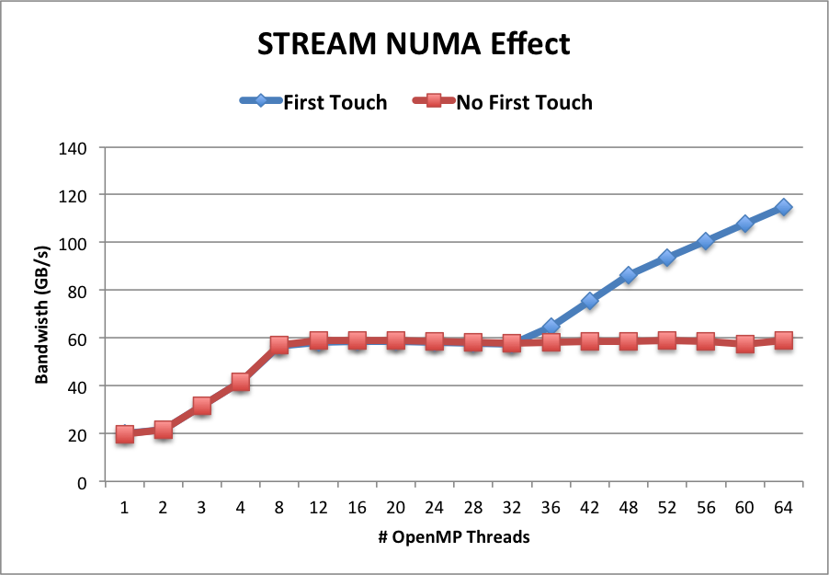
Memory Affinity: “First Touch” memory
Memory affinity is not defined when memory was allocated, instead it will be defined at initialization.
Memory will be local to the thread which initializes it. This is called first touch policy.
Hard to do “perfect touch” for real applications. General recommendation is to use number of threads fewer than number of CPUs (one or more MPI tasks) per NUMA domain.
Step 1.1 Initialization
by master thread only
for (j=0; j<VectorSize; j++) {
a[j] = 1.0; b[j] = 2.0; c[j] = 0.0;}
Step 1.2 Initialization
by all threads
#pragma omp parallel for
for (j=0; j<VectorSize; j++) {
a[j] = 1.0; b[j] = 2.0; c[j] = 0.0;}
Step 2 Compute
#pragma omp parallel for
for (j=0; j<VectorSize; j++) {
a[j]=b[j]+d*c[j];}
Red: step 1.1 + step 2. No First Touch
Blue: step 1.2 + step 2. First Touch
OMP_PROC_BIND=close

Slide 177
“Perfect Touch” is Hard
Hard to do “perfect touch” for real applications
General recommendation: use number of threads fewer than number of CPUs per NUMA domain
In the previous example, there are 16 cores (32 CPUs) per NUMA domain. Sample run options:
2 MPI tasks, 1 MPI task per NUMA domain, with 32 OpenMP threads (if using hyperthreads) or 16 OpenMP threads (if not using hyperthreads) per MPI task
4 MPI tasks, 2 MPI tasks per NUMA domain, with 16 OpenMP threads (if using hyperthreads) or 8 OpenMP threads (if not using hyperthreads) per MPI task
…

Slide 178
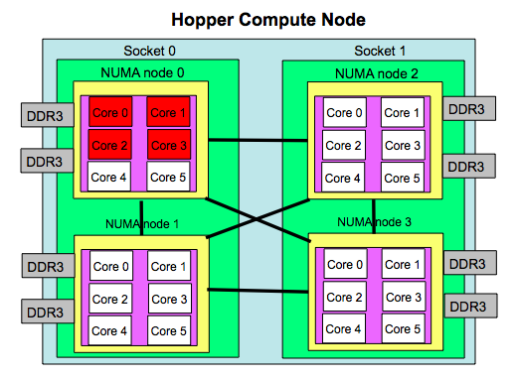
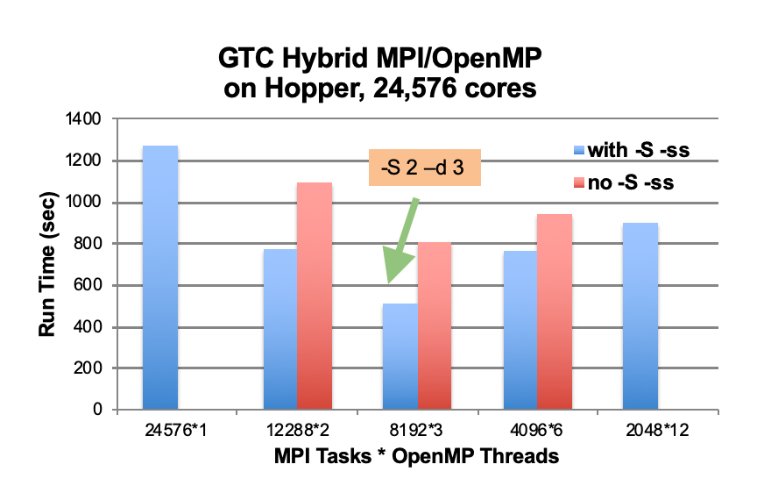
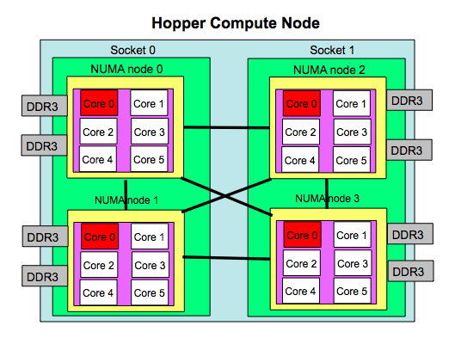
MPI Process Affinity Example: aprun “-S” Option
Important to spread MPI ranks evenly onto different NUMA nodes
Use the “-S” option: specify #MPI_tasks per NUMA domain
The example below was from an XE6 system (NERSC Hopper)
aprun –n 4 –d 6
aprun –n 4 –S 1–d 6

Slide 179
Exercise: Importance of First Touch
Do the same STREAM experiments with the no first touch code: “stream_nft.c” to understand the impact of first touch
Experiment with different OMP_NUM_THREADS, OMP_PROC_BIND, and OMP_PLACES, and OMP_DISPLAY_AFFINITY settings to check thread affinity output and performance result
Run with 8, 16, 32, 48, 64 threads, and OMP_PROC_BIND=spread or close
Compare your results with the previous STREAM plot

Slide 180
OpenMP task-to-data Affinity (in OpenMP 5.0)
Affinity hints can be provided for OpenMP tasks, resulting data to be closer to tasks
Useful for multi-socket systems
void task_affinity() {
double* B;
#pragma omp task shared(B) affinity(A[0:N])
B = init_B_and_important_computation(A);
#pragma omp task firstprivate(B) affinity(B[0:N])
important_computation_too(B);
#pragma omp taskwait
}

Slide 181
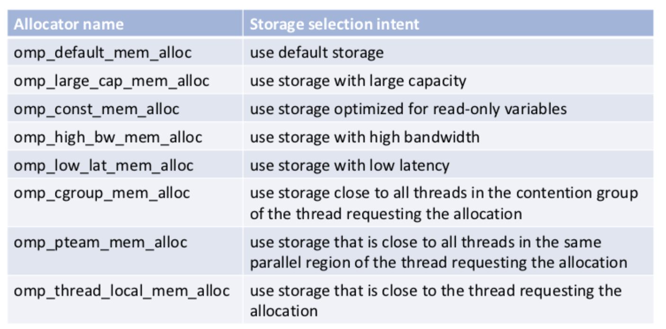
Memory Allocators (in OpenMP 5.0)
Support versatile types of memory available on current and future systems: DDR, High-Bandwidth Memory (HBM), non-volatile memory, constant memory
Memory allocators define types of memory that variables can be allocated to, such as large capacity, low latency, cgroup, thread local, etc.
181
Notes:
HH note: mention LBL requested this feature. TR5 complicated. TR7 (as in OpenMP5.0) much simpler

Slide 182
Using Memory Allocators
void allocator_example(omp_allocator_t *my_allocator) {
int a[M], b[N];
#pragma omp allocate(a) allocator(omp_high_bw_mem_alloc)
#pragma omp allocate(b) // use default OMP_ALLOCATOR
double *p = (double *) omp_alloc(N*M*sizeof(*p), my_allocator);
#pragma omp parallel private(a) allocate(omp_low_lat_mem_alloc:a)
{
some_parallel_code();
}
omp_free(p);
}
182
Notes:
HH note: mention LBL requested this feature. TR5 complicated. TR7 (as in OpenMP5.0) much simpler

Slide 183
A NUMA Case study

Slide 184
Benchmarking … I Must Control Everything!
Goal: To compare different programming systems applied to the same problem:
We must control everything we can to make sure any observed differences are due to the different programming systems.
We need to know exactly which cores we are using and how thread IDs map onto cores … so we can understand data detailed memory movement and make sure it’s the same between the different test cases.

Slide 185
Step 1: Know Your System
My system did not have numactl or Hwloc. So I went with my third option …. lscpu (note: I’m only showing a subset of the actual output):
$ lscpu
Architecture: x86_64
CPU op-mode(s): 32-bit, 64-bit
Byte Order: Little Endian
Address sizes: 46 bits physical, 48 bits virtual
CPU(s): 72
On-line CPU(s) list: 0-71
Thread(s) per core: 2
Core(s) per socket: 18
Socket(s): 2
NUMA node(s): 2
Vendor ID: GenuineIntel
CPU family: 6
Model: 63
Model name: Intel(R) Xeon(R) CPU E5-2699 v3 @ 2.30GHz
Stepping: 2
CPU MHz: 1197.539
CPU max MHz: 3600.0000
CPU min MHz: 1200.0000
L1d cache: 1.1 MiB
L1i cache: 1.1 MiB
L2 cache: 9 MiB
L3 cache: 90 MiB
NUMA node0 CPU(s): 0-17,36-53
NUMA node1 CPU(s): 18-35,54-71
SMT enabled … two HW threads per core
2 CPUs (sockets) with 18 physical cores per CPU
Note: a HW thread is a CPU (or core) as far as the OS is concerned. These two lines show you the numbering of these “cores”.

Slide 186
Step 1: Know Your System
My system did not have numactl or Hwloc. So I went with my third option …. lscpu (note: I’m only showing a subset of the actual output):
$ lscpu
Architecture: x86_64
CPU op-mode(s): 32-bit, 64-bit
Byte Order: Little Endian
Address sizes: 46 bits physical, 48 bits virtual
CPU(s): 72
On-line CPU(s) list: 0-71
Thread(s) per core: 2
Core(s) per socket: 18
Socket(s): 2
NUMA node(s): 2
Vendor ID: GenuineIntel
CPU family: 6
Model: 63
Model name: Intel(R) Xeon(R) CPU E5-2699 v3 @ 2.30GHz
Stepping: 2
CPU MHz: 1197.539
CPU max MHz: 3600.0000
CPU min MHz: 1200.0000
L1d cache: 1.1 MiB
L1i cache: 1.1 MiB
L2 cache: 9 MiB
L3 cache: 90 MiB
NUMA node0 CPU(s): 0-17,36-53
NUMA node1 CPU(s): 18-35,54-71
SMT enabled … two HW threads per core
2 CPUs (sockets) with 18 physical cores per CPU
The numbering of these “cores” (in 2 sockets).
0/36
1/37
2/38
3/39
4/40
5/41
6/42
7/43
8/44
9/45
10/46
11/47
12/48
13/49
14/50
15/51
16/52
17/53
18/54
19/55
20/56
21/57
22/58
23/59
24/60
25/61
26/62
27/63
28/64
29/65
30/66
31/67
32/68
33/69
34/70
35/71

Slide 187
Setup a Runscript (so you can reproduce the computations later)
#! /usr/bin/env bash
# Run script for DGEMM with C and OpenMP
# Define shared parameters for the calculations we will run
BLOCK=0
ORDER=1000
ITERS=5
# setup environment for the intel compilers
source /opt/intel/compilers_and_libraries_2020.4.304/linux/bin/compilervars.sh -arch intel64
# Setup display of mapping from OpenMP threads to "hardware" threads.
export OMP_DISPLAY_AFFINITY=true
export OMP_AFFINITY_FORMAT="Thrd Lev=%3L, thrd_num=%5n, thrd_aff=%15A"
# Enable explicit affinity control.
export OMP_PLACES="{0},{1},{2},{3},{4},{5},{6},{7},{8},{9},{10},{11},{12},{13},{14},{15},{16}"
export OMP_PROC_BIND=close
./dgemm 8 $ITERS $ORDER $BLOCK
./dgemm 16 $ITERS $ORDER $BLOCK

Slide 188
A NUMA Case Study: Results
Parallel Research Kernels version 2.17
OpenMP Dense matrix-matrix multiplication
Thrd Lev=1 , thrd_num=0 , thrd_aff=0
Thrd Lev=1 , thrd_num=4 , thrd_aff=4
Thrd Lev=1 , thrd_num=3 , thrd_aff=3
Thrd Lev=1 , thrd_num=5 , thrd_aff=5
Thrd Lev=1 , thrd_num=1 , thrd_aff=1
Thrd Lev=1 , thrd_num=2 , thrd_aff=2
Thrd Lev=1 , thrd_num=6 , thrd_aff=6
Thrd Lev=1 , thrd_num=7 , thrd_aff=7
Matrix order = 1000
Number of threads = 8
Rate : 21650.601956 +/- 1589.413250 MFlops/s
Parallel Research Kernels version 2.17
OpenMP Dense matrix-matrix multiplication
Thrd Lev=1 , thrd_num=0 , thrd_aff=0
Thrd Lev=1 , thrd_num=13 , thrd_aff=13
Thrd Lev=1 , thrd_num=4 , thrd_aff=4
Thrd Lev=1 , thrd_num=11 , thrd_aff=11
Thrd Lev=1 , thrd_num=10 , thrd_aff=10
Thrd Lev=1 , thrd_num=8 , thrd_aff=8
Thrd Lev=1 , thrd_num=9 , thrd_aff=9
Thrd Lev=1 , thrd_num=1 , thrd_aff=1
Thrd Lev=1 , thrd_num=3 , thrd_aff=3
Thrd Lev=1 , thrd_num=2 , thrd_aff=2
Thrd Lev=1 , thrd_num=12 , thrd_aff=12
Thrd Lev=1 , thrd_num=7 , thrd_aff=7
Thrd Lev=1 , thrd_num=6 , thrd_aff=6
Thrd Lev=1 , thrd_num=5 , thrd_aff=5
Thrd Lev=1 , thrd_num=14 , thrd_aff=14
Thrd Lev=1 , thrd_num=15 , thrd_aff=15
Matrix order = 1000
Number of threads = 16
Rate : 38765.867067 +/- 3303.460980 MFlops/s
Notice the one-to-one mapping of thread ID onto hardware thread.
Normally, this is going too far, but for benchmarking, this is a handy trick.

Slide 189
Obtain Optimal Affinity on Cori KNL Example

Slide 190
KNL Compute Nodes
A Cori KNL node has 68 cores/272 CPUs, 96 GB DDR memory, 16 GB high bandwidth on package memory (MCDRAM)
A quad,cache node (default setting) has only 1 NUMA node with all CPUs on the NUMA node 0 (DDR memory). MCDRAM is hidden from the “numactl -H” result since it is a cache.

Slide 191
Can We Just Do a Naive srun?
Example: 16 MPI tasks x 8 OpenMP threads per task on a single 68-core KNL quad,cache node:
% export OMP_NUM_THREADS=8
% export OMP_PROC_BIND=spread (other choice are “close”,”master”,”true”,”false”)
% export OMP_PLACES=threads (other choices are: cores, sockets, and various ways to specify explicit lists, etc.)
% srun -n 16 ./xthi |sort -k4n,6n or % mpirun –n 16 ./xthi
Hello from rank 0, thread 0, on nid02304. (core affinity = 0)
Hello from rank 0, thread 1, on nid02304. (core affinity = 144) (on physical core 8)
Hello from rank 0, thread 2, on nid02304. (core affinity = 17)
Hello from rank 0, thread 3, on nid02304. (core affinity = 161) (on physical core 25)
…
Hello from rank 1, thread 0, on nid02304. (core affinity = 0)
Hello from rank 1, thread 1, on nid02304. (core affinity = 144)
It is a mess! e.g., thread 0 for rank 0, and thread 1 for rank 1 are on same physical core 0

Slide 192
MPI Process Affinity: Selected Slurm srun Options
--cpu-bind=threads
Automatically generate masks binding tasks to threads
--cpu-bind=cores
Automatically generate masks binding tasks to cores
--cpu-bind=sockets
Automatically generate masks binding tasks to sockets
--cpu-bind=map_cpu:<cpulist>
Bind by setting CPU masks on tasks (or ranks)
--cpu-bind=map_ldom:<NUMA_domain_list>
Bind by mapping NUMA locality domain IDs to tasks
(ldom means logical domain)

Slide 193
Example mpirun or srun Commands: Fix the Problem
The reason is #MPI tasks is not divisible by 68!
Each MPI task is getting 68x4/#MPI tasks of logical cores as the domain size
MPI tasks are crossing tile boundaries
Let’s set number of logical cores per MPI task manually by wasting extra 4 cores on purpose, which is 256/#MPI tasks
Cray MPICH with Aries network using native SLURM
% srun -n 16 -c 16 --cpu_bind=cores ./code.exe
Notes: Here the value for -c is also set to number of logical cores per MPI task, i.e., 256/#MPI tasks.
Intel MPI with Omni Path using mpirun:
% export I_MPI_PIN_DOMAIN=16
% mpirun -n 16 ./code.exe

Slide 194
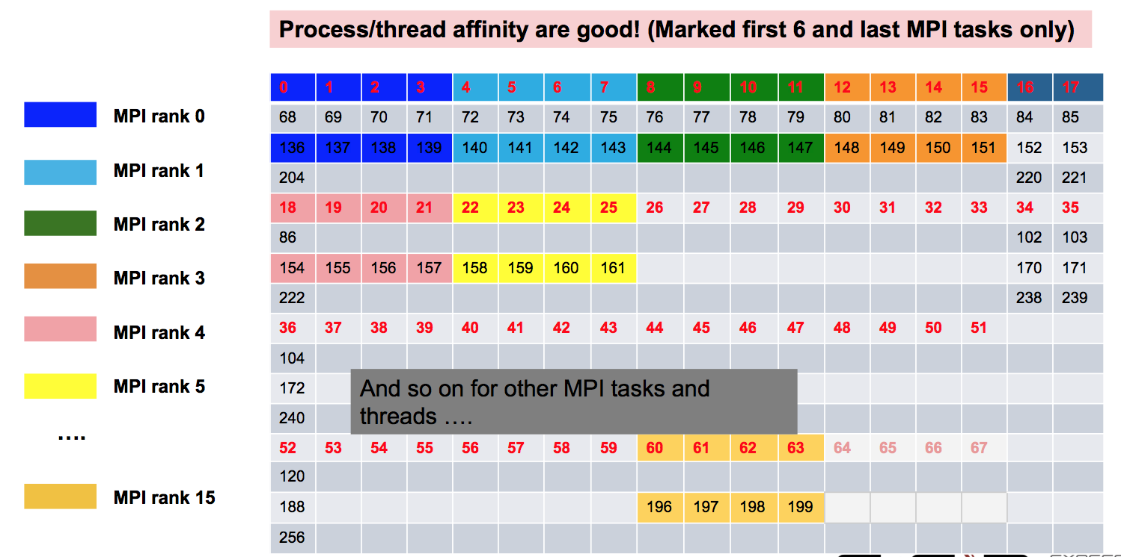
Now It Looks Good!

Slide 195
Intel KNL Quad,Flat Node Example
Cori KNL quad,flat node example
68 cores (272 CPUs)
% numactl –H
available: 2 nodes (0-1)
node 0 cpus: 0 1 2 3 4 5 6 7 8 9 10 11 12 13 14 15 16 17 18 19 20 21 22 23 24 25 26 27 28 29 30 31 32 33 34 35 36 37 38 39 40 41 42 43 44 45 46 47 48 49 50 51 52 53 54 55 56 57 58 59 60 61 62 63 64 65 66 67 68 69 70 71 72 73 74 75 76 77 78 79 80 81 82 83 84 85 86 87 88 89 90 91 92 93 94 95 96 97 98 99 100 101 102 103 104 105 106 107 108 109 110 111 112 113 114 115 116 117 118 119 120 121 122 123 124 125 126 127 128 129 130 131 132 133 134 135 136 137 138 139 140 141 142 143 144 145 146 147 148 149 150 151 152 153 154 155 156 157 158 159 160 161 162 163 164 165 166 167 168 169 170 171 172 173 174 175 176 177 178 179 180 181 182 183 184 185 186 187 188 189 190 191 192 193 194 195 196 197 198 199 200 201 202 203 204 205 206 207 208 209 210 211 212 213 214 215 216 217 218 219 220 221 222 223 224 225 226 227 228 229 230 231 232 233 234 235 236 237 238 239 240 241 242 243 244 245 246 247 248 249 250 251 252 253 254 255 256 257 258 259 260 261 262 263 264 265 266 267 268 269 270 271
node 0 size: 96723 MB
node 0 free: 93924 MB
node 1 cpus:
node 1 size: 16157 MB
node 1 free: 16088 MB
node distances:
node 0 1
0: 10 31
1: 31 10
The quad,flat mode has only 2 NUMA nodes with all CPUs on the NUMA node 0 (DDR memory).
And NUMA node 1 has MCDRAM (high bandwidth memory).

Slide 196
Essential Runtime Settings for KNL MCDRAM Memory Affinity
In quad, cache mode, no special setting is needed to use MCDRAM
In quad,flat mode, using quad,flat as an example
NUMA node 1 is MCDRAM
Enforced memory mapping to MCDRAM
If using >16 GB, malloc will fail
Use “numactl -m 1 ./myapp” as the executable
(instead of “./myapp”)
Preferred memory mapping to MCDRAM
If using >16 GB, malloc will spill to DDR
Use “numactl -p 1 ./myapp” as the executable
(instead of “./myapp”)

Slide 197
Process and Thread Affinity Best Practices
Achieving best data locality, and optimal process and thread affinity is crucial in getting good performance with MPI/OpenMP, yet not straightforward
Understand the node architecture with tools such as “numactl -H” first
Set correct cpu-bind and OMP_PLACES options
Always use simple examples with the same settings for your real application to verify affinity first or check with OMP_DISPLAY_AFFINITY
For nested OpenMP, set OMP_PROC_BIND=spread,close is recommended
Optimize code for memory affinity
Pay special attention to avoid false sharing
Exploit first touch data policy, or use at least 1 MPI task per NUMA domain
Optimize code for cache locality
Compare performance with put threads close or far apart (spread)
Use omp_allocator
Use numactl -m option to explicitly request memory allocation in specific NUMA domain (such as high bandwidth memory in KNL)

Slide 198
Outline
Introduction to OpenMP
Creating Threads
Synchronization
Parallel Loops
Data Environment
Memory Model
Irregular Parallelism and Tasks
Recap
Beyond the Common Core:
Worksharing Revisited
Synchronization Revisited: Options for Mutual exclusion
Thread Affinity and Data Locality
Thread Private Data
Memory models and point-to-point Synchronization
Programming your GPU with OpenMP

Slide 199
Data Sharing: Threadprivate
Makes global data private to a thread
Fortran: COMMON blocks
C: File scope and static variables, static class members
Different from making them PRIVATE
with PRIVATE global variables are masked.
THREADPRIVATE preserves global scope within each thread
Threadprivate variables can be initialized using COPYIN or at time of definition (using language-defined initialization capabilities)

Slide 200
A Threadprivate Example (C)
Use threadprivate to create a counter for each thread.
int counter = 0;
#pragma omp threadprivate(counter)
int increment_counter()
{
counter++;
return (counter);
}

Slide 201
Data Copying: Copyin
You initialize threadprivate data using a copyin clause.
parameter (N=1000)
common/buf/A(N)
!$OMP THREADPRIVATE(/buf/)
!$ Initialize the A array
call init_data(N,A)
!$OMP PARALLEL COPYIN(A)
… Now each thread sees threadprivate array A initialized
… to the global value set in the subroutine init_data()
!$OMP END PARALLEL
end

Slide 202
Exercise: Monte Carlo Calculations Using random numbers to solve tough problems
Sample a problem domain to estimate areas, compute probabilities, find optimal values, etc.
Example: Computing π with a digital dart board:
2 * r
Throw darts at the circle/square.
Chance of falling in circle is proportional to ratio of areas:
A_{c} = r² * π
A_{s} = (2*r) * (2*r) = 4 * r²
P = A_{c}/A_{s} = π /4
Compute π by randomly choosing points; π is four times the fraction that falls in the circle
N= 10 π = 2.8
N=100 π = 3.16
N= 1000 π = 3.148
Notes:
A(circle) = pi * r^2
A(square) = (2*r)*(2*r) = 4*r^2
ratio = A(circle)/A(square) = pi/4
Since the probability (P) of a dart falling inside a figure (i.e. the square
or the circle) is proportional to the area, we have
ratio = P(circle)/P(square) = pi/4
If I throw N darts as computed by random numbers evenly distributed
over the area of the square
P(sqaure) = N/N .... i.e. every dart lands in the square
P(circle) = N(circle)/N
ratio = (N(circle)/N)/(N/N) = N(circle)/N
Hence, to find the area, I compute N random "darts" and count how many fall
inside the circle. The equation for a circle is
x^2 + y^2 = r^2
So I randomly compute "x" and "y" evenly distributed from -r to r and
count the "dart" as falling inside the cicle if
x^2 + y^2 < or = r

Slide 203
Exercise: Monte Carlo pi (cont)
We provide three files for this exercise
pi_mc.c: the Monte Carlo method pi program
random.c: a simple random number generator
random.h: include file for random number generator
Create a parallel version of this program.
Run it multiple times with varying numbers of threads.
Is the program working correctly? Is there anything wrong?

Slide 204
Parallel Programmers love Monte Carlo algorithms
Embarrassingly parallel: the parallelism is so easy its embarrassing.
Add two lines and you have a parallel program.
#include “omp.h”
static long num_trials = 10000;
int main ()
{
long i; long Ncirc = 0; double pi, x, y;
double r = 1.0; // radius of circle. Side of squrare is 2*r
seed(0,-r, r); // The circle and square are centered at the origin
#pragma omp parallel for private (x, y) reduction (+:Ncirc)
for(i=0;i<num_trials; i++)
{
x = random(); y = random();
if ( x*x + y*y) <= r*r) Ncirc++;
}
pi = 4.0 * ((double)Ncirc/(double)num_trials);
printf("\n %d trials, pi is %f \n",num_trials, pi);
}

Slide 205
Random Numbers: Linear Congruential Generator (LCG)
LCG: Easy to write, cheap to compute, portable, OK quality
random_next = (MULTIPLIER * random_last + ADDEND)% PMOD;
random_last = random_next;
If you pick the multiplier and addend correctly, LCG has a period of PMOD.
Picking good LCG parameters is complicated, so look it up (Numerical Recipes is a good source). I used the following:
MULTIPLIER = 1366
ADDEND = 150889
PMOD = 714025

Slide 206
LCG code
static long MULTIPLIER = 1366;
static long ADDEND = 150889;
static long PMOD = 714025;
long random_last = 0;
double random ()
{
long random_next;
random_next = (MULTIPLIER * random_last + ADDEND)% PMOD;
random_last = random_next;
return ((double)random_next/(double)PMOD);
}
Seed the pseudo random sequence by setting random_last

Slide 207
Running the PI_MC program with LCG generator
Log₁₀ number of samples
Run the same program the same way and get different answers!
That is not acceptable!
Issue: my LCG generator is not threadsafe
Log ₁₀ Relative error
Program written using the Intel C/C++ compiler (10.0.659.2005) in Microsoft Visual studio 2005 (8.0.50727.42) and running on a dual-core laptop (Intel T2400 @ 1.83 Ghz with 2 GB RAM) running Microsoft Windows XP.

Slide 208
Exercise: Monte Carlo pi (cont)
Create a threadsafe version of the monte carlo pi program
Do not change the interfaces to functions in random.c
This is an exercise in modular software … why should a user of your parallel random number generator have to know any details of the generator or make any changes to how the generator is called?
The random number generator must be thread-safe
Verify that the program is thread safe by running multiple times for a fixed number of threads.
Any concerns with the program behavior?

Slide 209
LCG code: threadsafe version
random_last carries state between random number computations,
To make the generator threadsafe, make random_last threadprivate so each thread has its own copy.
static long MULTIPLIER = 1366;
static long ADDEND = 150889;
static long PMOD = 714025;
long random_last = 0;
#pragma omp threadprivate(random_last)
double random ()
{
long random_next;
random_next = (MULTIPLIER * random_last + ADDEND)% PMOD;
random_last = random_next;
return ((double)random_next/(double)PMOD);
}

Slide 210
Thread Safe Random Number Generators
Log₁₀ number of samples
Thread safe version gives the same answer each time you run the program.
But for large number of samples, its quality is lower than the one thread result!
Why?
Log₁₀ Relative error

Slide 211
Pseudo Random Sequences
Random number Generators (RNGs) define a sequence of pseudo-random numbers of length equal to the period of the RNG
In a typical problem, you grab a subsequence of the RNG range
Seed determines starting point
Grab arbitrary seeds and you may generate overlapping sequences
E.g. three sequences … last one wraps at the end of the RNG period.
Thread 1
Thread 2
Thread 3
Overlapping sequences = over-sampling and bad statistics … lower quality or even wrong answers!

Slide 212
Parallel random number generators
Multiple threads cooperate to generate and use random numbers.
Solutions:
Replicate and Pray
Give each thread a separate, independent generator
Have one thread generate all the numbers.
Leapfrog … deal out sequence values “round robin” as if dealing a deck of cards.
Block method … pick your seed so each threads gets a distinct contiguous block.
Other than “replicate and pray”, these are difficult to implement. Be smart … get a math library that does it right.
If done right, can generate the same sequence regardless of the number of threads …
Nice for debugging, but not really needed scientifically.
Intel’s Math kernel Library supports a wide range of parallel random number generators.
For an open alternative, the state of the art is the Scalable Parallel Random Number Generators Library (SPRNG): http://www.sprng.org/ from Michael Mascagni’s group at Florida State University.

Slide 213
MKL Random Number Generators (RNG)
MKL includes several families of RNGs in its vector statistics library.
Specialized to efficiently generate vectors of random numbers
#define BLOCK 100
double buff[BLOCK];
VSLStreamStatePtr stream;
vslNewStream(&ran_stream, VSL_BRNG_WH, (int)seed_val);
vdRngUniform (VSL_METHOD_DUNIFORM_STD, stream, BLOCK, buff, low, hi)
vslDeleteStream( &stream );
Select type of RNG and set seed
Initialize a stream or pseudo random numbers
Fill buff with BLOCK pseudo rand. nums, uniformly distributed with values between lo and hi.
Delete the stream when you are done

Slide 214
Wichmann-Hill Generators (WH)
WH is a family of 273 parameter sets each defining a non-overlapping and independent RNG.
Easy to use, just make each stream threadprivate and initiate RNG stream so each thread gets a unique WG RNG.
VSLStreamStatePtr stream;
#pragma omp threadprivate(stream)
…
vslNewStream(&ran_stream, VSL_BRNG_WH+Thrd_ID, (int)seed);

Slide 215
Independent Generator for each thread
Log₁₀ number of samples
Notice that once you get beyond the high error, small sample count range, adding threads doesn’t decrease quality of random sampling.
Log₁₀ Relative error

Slide 216
Leap Frog Method
Interleave samples in the sequence of pseudo random numbers:
Thread i starts at the i^{th} number in the sequence
Stride through sequence, stride length = number of threads.
Result … the same sequence of values regardless of the number of threads.
#pragma omp single
{ nthreads = omp_get_num_threads();
iseed = PMOD/MULTIPLIER; // just pick a seed
pseed[0] = iseed;
mult_n = MULTIPLIER;
for (i = 1; i < nthreads; ++i)
{
iseed = (unsigned long long)((MULTIPLIER * iseed) % PMOD);
pseed[i] = iseed;
mult_n = (mult_n * MULTIPLIER) % PMOD;
}
}
random_last = (unsigned long long) pseed[id];
One thread computes offsets and strided multiplier
LCG with Addend = 0 just to keep things simple
Each thread stores offset starting point into its threadprivate “last random” value

Slide 217
Same sequence with many threads.
We can use the leapfrog method to generate the same answer for any number of threads
Steps | One thread | 2 threads | 4 threads
1000 | 3.156 | 3.156 | 3.156
10000 | 3.1168 | 3.1168 | 3.1168
100000 | 3.13964 | 3.13964 | 3.13964
1000000 | 3.140348 | 3.140348 | 3.140348
10000000 | 3.141658 | 3.141658 | 3.141658
Used the MKL library with two generator streams per computation: one for the x values (WH) and one for the y values (WH+1). Also used the leapfrog method to deal out iterations among threads.

Slide 218
Outline
Introduction to OpenMP
Creating Threads
Synchronization
Parallel Loops
Data Environment
Memory Model
Irregular Parallelism and Tasks
Recap
Beyond the Common Core:
Worksharing Revisited
Synchronization Revisited: Options for Mutual exclusion
Thread Affinity and Data Locality
Thread Private Data
Memory models and point-to-point Synchronization
Programming your GPU with OpenMP

Slide 219
OpenMP Memory Model
OpenMP supports a shared memory model
All threads share an address space, where variable can be stored or retrieved:
Shared memory
a
cache1
cache2
cache3
cacheN
. . .
proc1
proc2
proc3
procN
a
Threads maintain their own temporary view of memory as well … the details of which are not defined in OpenMP but this temporary view typically resides in caches, registers, write-buffers, etc.

Slide 220
Flush Operation
Defines a sequence point at which a thread enforces a consistent view of memory.
For variables visible to other threads and associated with the flush operation (the flush-set)
The compiler can’t move loads/stores of the flush-set around a flush:
All previous read/writes of the flush-set by this thread have completed
No subsequent read/writes of the flush-set by this thread have occurred
Variables in the flush set are moved from temporary storage to shared memory.
Reads of variables in the flush set following the flush are loaded from shared memory.
IMPORTANT POINT: The flush makes the calling threads temporary view match the view in shared memory. Flush by itself does not force synchronization.

Slide 221
Memory Consistency: Flush Example
Flush forces data to be updated in memory so other threads see the most recent value
Flush without a list: flush set is all thread visible variables
Flush with a list: flush set is the list of variables
double A;
A = compute();
#pragma omp flush(A)
// flush to memory to make sure other // threads can pick up the right value
Note: OpenMP’s flush is analogous to a fence in other shared memory APIs

Slide 222
Flush and Synchronization
A flush operation is implied by OpenMP synchronizations, e.g.,
at entry/exit of parallel regions
at implicit and explicit barriers
at entry/exit of critical regions
whenever a lock is set or unset
….
(but not at entry to worksharing regions or entry/exit of primary* regions)
*the term “master” has been deprecated in OpenMP 5.1 and replaced with the term “primary”.

Slide 223
Example: prod_cons.c
Parallelize a producer/consumer program
One thread produces values that another thread consumes.
int main()
{
double *A, sum, runtime; int flag = 0;
A = (double *) malloc(N*sizeof(double));
runtime = omp_get_wtime();
fill_rand(N, A); // Producer: fill an array of data
sum = Sum_array(N, A); // Consumer: sum the array
runtime = omp_get_wtime() - runtime;
printf(" In %lf secs, The sum is %lf \n",runtime,sum);
}
Often used with a stream of produced values to implement “pipeline parallelism”
The key is to implement pairwise synchronization between threads

Slide 224
Pairwise Synchronization in OpenMP
OpenMP lacks synchronization constructs that work between pairs of threads.
When needed, you have to build it yourself.
Pairwise synchronization
Use a shared flag variable
Reader spins waiting for the new flag value
Use flushes to force updates to and from memory

Slide 225
Exercise: Producer/Consumer
int main()
{
double *A, sum, runtime; int numthreads, flag = 0;
A = (double *)malloc(N*sizeof(double));
#pragma omp parallel sections
{
#pragma omp section
{
fill_rand(N, A);
flag = 1;
}
#pragma omp section
{
while (flag == 0){
}
sum = Sum_array(N, A);
}
}
}
Put the flushes in the right places to make this program race-free.
Do you need any other synchronization constructs to make this work?
Notes:
Note the volatile keyword in C doesn’t understand multi-threaded execution. So just making flag volatile doesn’t help you. This may change as we move to C++’11.

Slide 226
Solution (try 1): Producer/Consumer
int main()
{
double *A, sum, runtime; int numthreads, flag = 0;
A = (double *)malloc(N*sizeof(double));
#pragma omp parallel sections
{
#pragma omp section
{
fill_rand(N, A);
#pragma omp flush
flag = 1;
#pragma omp flush (flag)
}
#pragma omp section
{
#pragma omp flush (flag)
while (flag == 0){
#pragma omp flush (flag)
}
#pragma omp flush
sum = Sum_array(N, A);
}
}
}
Use flag to Signal when the “produced” value is ready
Flush forces refresh to memory; guarantees that the other thread sees the new value of A
Flush needed on both “reader” and “writer” sides of the communication
Notice you must put the flush inside the while loop to make sure the updated flag variable is seen
This program works with the x86 memory model (loads and stores use relaxed atomics), but it technically has a race … on the store and later load of flag
Notes:
Note the volatile keyword in C doesn’t understand multi-threaded execution. So just making flag volatile doesn’t help you. This may change as we move to C++’11.

Slide 227
The OpenMP 3.1 Atomics (1 of 2)
Atomic was expanded to cover the full range of common scenarios where you need to protect a memory operation so it occurs atomically:
# pragma omp atomic [read | write | update | capture]
Atomic can protect loads
# pragma omp atomic read
v = x;
Atomic can protect stores
# pragma omp atomic write
x = expr;
Atomic can protect updates to a storage location (this is the default behavior … i.e. when you don’t provide a clause)
# pragma omp atomic update
x++; or ++x; or x--; or –x; or
x binop= expr; or x = x binop expr;
This is the original OpenMP atomic

Slide 228
The OpenMP 3.1 Atomics (2 of 2)
Atomic can protect the assignment of a value (its capture) AND an associated update operation:
# pragma omp atomic capture
statement or structured block
Where the statement is one of the following forms:
v = x++; v = ++x; v = x--; v = –x; v = x binop expr;
Where the structured block is one of the following forms:
{v = x; x binop = expr;} | {x binop = expr; v = x;}
{v=x; x=x binop expr;} | {X = x binop expr; v = x;}
{v = x; x++;} | {v=x; ++x:}
{++x; v=x:} | {x++; v = x;}
{v = x; x--;} | {v= x; --x;}
{--x; v = x;} | {x--; v = x;}
The capture semantics in atomic were added to map onto common hardware supported atomic operations and to support modern lock free algorithms

Slide 229
Atomics and Synchronization Flags
int main()
{ double *A, sum, runtime;
int numthreads, flag = 0, flg_tmp;
A = (double *)malloc(N*sizeof(double));
#pragma omp parallel sections
{
#pragma omp section
{ fill_rand(N, A);
#pragma omp flush
#pragma omp atomic write
flag = 1;
#pragma omp flush (flag)
}
#pragma omp section
{ while (1){
#pragma omp flush(flag)
#pragma omp atomic read
flg_tmp= flag;
if (flg_tmp==1) break;
}
#pragma omp flush
sum = Sum_array(N, A);
}
}
}
This program is truly race free … the reads and writes of flag are protected so the two threads cannot conflict
Still painful and error prone due to all of the flushes that are required
Notes:
The volatile keyword was not defined with threads in mind, hence it doesn’t forece consistency a required for threads. For Java, however, the volatil keyword is useful fo rsolving this problem.

Slide 230
OpenMP 4.0 Atomic: Sequential consistency
4.0
Sequential consistency:
The order of loads and stores in a race-free program appear in some interleaved order and all threads in the team see this same order.
OpenMP 4.0 added an optional clause to atomics
#pragma omp atomic [read | write | update | capture] [seq_cst]
In more pragmatic terms:
If the seq_cst clause is included, OpenMP adds a flush without an argument list to the atomic operation so you don’t need to.
In terms of the C++’11 memory model:
Use of the seq_cst clause makes atomics follow the sequentially consistent memory order.
Leaving off the seq_cst clause makes the atomics relaxed.
Advice to programmers: save yourself a world of hurt … let OpenMP take care of your flushes for you whenever possible … use seq_cst

Slide 231
Atomics and Synchronization Flags (4.0)
int main()
{ double *A, sum, runtime;
int numthreads, flag = 0, flg_tmp;
A = (double *)malloc(N*sizeof(double));
#pragma omp parallel sections
{
#pragma omp section
{ fill_rand(N, A);
#pragma omp atomic write seq_cst
flag = 1;
}
#pragma omp section
{ while (1){
#pragma omp atomic read seq_cst
flg_tmp= flag;
if (flg_tmp==1) break;
}
sum = Sum_array(N, A);
}
}
}
This program is truly race free … the reads and writes of flag are protected so the two threads cannot conflict – and you do not use any explicit flush constructs (OpenMP does them for you)
Notes:
The volatile keyword was not defined with threads in mind, hence it doesn’t forece consistency a required for threads. For Java, however, the volatil keyword is useful fo rsolving this problem.

Slide 232
Outline
Introduction to OpenMP
Creating Threads
Synchronization
Parallel Loops
Data Environment
Memory Model
Irregular Parallelism and Tasks
Recap
Beyond the Common Core:
Worksharing Revisited
Synchronization Revisited: Options for Mutual exclusion
Thread Affinity and Data Locality
Thread Private Data
Memory models and point-to-point Synchronization
Programming your GPU with OpenMP

Slide 233
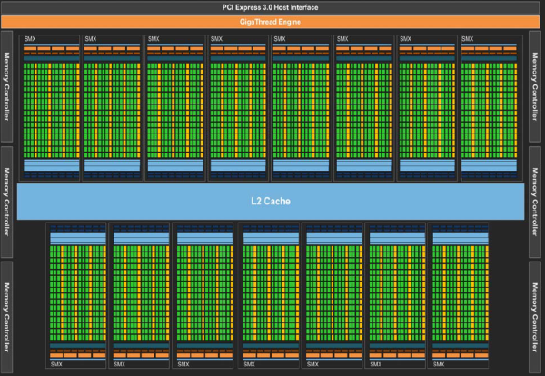
How do we execute code on a GPU: The SIMT model (Single Instruction Multiple Thread)
Turn source code into a scalar work-item
Map work-items onto an N dim index space.
Run on hardware designed around the same SIMT execution model
extern void reduce( __local float*, __global float*);
__kernel void pi( const int niters, float step_size, __local float* l_sums, __global float* p_sums)
{
int n_wrk_items = get_local_size(0);
int loc_id = get_local_id(0);
int grp_id = get_group_id(0);
float x, accum = 0.0f; int i,istart,iend;
istart = (grp_id * n_wrk_items + loc_id) * niters;
iend = istart+niters;
for(i= istart; i<iend; i++){
x = (i+0.5f)*step_size; accum += 4.0f/(1.0f+x*x); }
l_sums[local_id] = accum;
barrier(CLK_LOCAL_MEM_FENCE);
reduce(l_sums, p_sums);
}
Map data structures onto the same index space
This is OpenCL kernel code … the sort of code the OpenMP compiler generates on your behalf
Third Party names are the property of their owners

Slide 234
How do we execute code on a GPU: OpenCL and CUDA nomenclature
Organize work-items into work-groups and map onto an an N dim index space. CUDA calls a work-group a thread-block
Turn source code into a scalar work-item (a CUDA thread)
Submit a kernel to an OpenCL command queue or a CUDA stream
extern void reduce( __local float*, __global float*);
__kernel void pi( const int niters, float step_size, __local float* l_sums, __global float* p_sums)
{
int n_wrk_items = get_local_size(0);
int loc_id = get_local_id(0);
int grp_id = get_group_id(0);
float x, accum = 0.0f; int i,istart,iend;
istart = (grp_id * n_wrk_items + loc_id) * niters;
iend = istart+niters;
for(i= istart; i<iend; i++){
x = (i+0.5f)*step_size; accum += 4.0f/(1.0f+x*x); }
l_sums[local_id] = accum;
barrier(CLK_LOCAL_MEM_FENCE);
reduce(l_sums, p_sums);
}
OpenCL index space is called an NDRange. CUDA calls this a Grid
This code defines a kernel
It’s called SIMT, but GPUs are really vector-architectures with a block of work-items executing together (a subgroup in OpenCL or a warp with CUDA)
Third Party names are the property of their owners

Slide 235
A Generic Host/Device Platform Model
…
…
…
…
…
…
…
Processing Element
…
…
Host
…
…
…
…
…
…
Compute Unit
Device
One Host and one or more Devices
Each Device is composed of one or more Compute Units
Each Compute Unit is divided into one or more Processing Elements
Memory divided into host memory and device memory
Third party names are the property of their owners.

Slide 236
OpenMP Basic Definitions: Solution stack
End User
User layer
Application
Prog. Layer
Directives,
Compiler
OpenMP library
Environment variables
OpenMP Runtime library
System layer
OS/system support for shared memory and threading
HW
Shared address space (NUMA)
CPU cores
SIMD units
GPU cores
236

Slide 237
Accelerated workshare v1.0
Host thread
Simply add a target construct
Transfer control of execution to a SINGLE device thread
Only one team of threads workshares the loop
Device initial thread
#pragma omp target
#pragma omp parallel for
for (i=0;i<N;i++)
…
Device
thread
team

Slide 238
The target data environment
Remember: distinct memory spaces on host and device.
OpenMP uses a combination of implicit and explicit memory movement.
Data may move between the host and the device in well defined places:
Firstly, at the beginning and end of a target region: #pragma omp target { // Data may move here … } // and here
We’ll discuss the other places later…

Slide 239
Default Data Mapping: implicit movement with a target region
Scalar variables:
Examples:
int N; double x;
OpenMP implicitly maps scalar variables as firstprivate
A new value per work-item initialized with the original value (in OpenCL nomenclature, the firstprivate goes in private memory).
The variable is not copied back to the host at the end of the target region.
OpenMP target regions for GPUs execute with CUDA/OpenCL, and a firstprivate scalar can be launched as a parameter to a kernel function without the overhead of setting up a variable in device memory.

Slide 240
Default Data Mapping: implicit movement with a target region
Non-scalar variables:
Must have a complete type.
Example: fixed sized (stack) array:
double A[1000];
Copied to the device at the start of the target region, and copied back at the end. In OpenCL nomenclature, these are placed in device global memory.
A new value is created in the target region and initialized with the original data, but it is shared between threads on the device. Data is copied back to the host at the end of the target region.
OpenMP calls this mapping tofrom

Slide 241
Default Data Mapping: implicit movement with a target region
Pointers and their data:
Example: arrays allocated on the heap
double *A = malloc(sizeof(double)*1000);
The pointer value will be mapped.
But the data it points to will not be mapped by default.

Slide 242
The target data environment
Scalars and statically allocated arrays are moved onto the device by default before execution
Host thread
Generating Task
float A[N], B[N];
A, B and N mapped to the device
#pragma omp target
Initial task
Host thread
waits for the task region to complete
{
target region, can use A, B and N
}
Target task
Device Initial thread
the arrays A and B mapped back to the host
Only the statically allocated arrays are moved back to the host after the target region completes
Based on figure 6.4 in Using OpenMP – The Next Step by van der Pas, Stotzer and Terboven, MIT Press, 2017

Slide 243
Default Data Sharing: example
1. Variables created in host memory.
int main(void) {
int N = 1024;
double A[N], B[N];
#pragma omp target
{
for (int ii = 0; ii < N; ++ii) {
A[ii] = A[ii] + B[ii];
}
} // end of target region
}
2. Scalar N and stack arrays A and B are copied to device memory. Execution transferred to device.
3. ii is private on the device as it’s declared within the target region
4. Execution on the device.
5. stack arrays A and B are copied from device memory back to the host. Host resumes execution.

Slide 244
Explicit Data Sharing
Previously, we described the rules for implicit data movement.
We explicitly control the movement of data using the map clause.
Data allocated on the heap needs to explicitly copied to/from the device:
int main(void) {
int ii=0, N = 1024;
int* A = malloc(sizeof(int)*N);
#pragma omp target
{
// N, ii and A all exist here
// The data that A points to (*A , A[ii]) DOES NOT exist here!
} }

Slide 245
Controlling data movement
Data movement defined from the host perspective.
int i, a[N], b[N], c[N];
#pragma omp target map(to:a,b) map(tofrom:c)
The various forms of the map clause
map(to:list): On entering the region, variables in the list are initialized on the device using the original values from the host (host to device copy).
map(from:list): At the end of the target region, the values from variables in the list are copied into the original variables (device to host copy). On entering the region, initial value of the variable is not initialized.
map(tofrom:list): the effect of both a map-to and a map-from (host to device copy at start of region, device to host copy at end)
map(alloc:list): On entering the region, data is allocated and uninitialized on the device.
map(list): equivalent to map(tofrom:list).
For pointers you must use array section notation ..
map(to:a[0:N]). Notation is A[lower-bound : length]

Slide 246
Moving arrays with the map clause
int main(void) {
int N = 1024;
int* A = malloc(sizeof(int)*N);
#pragma omp target map(A[0:N])
{
// N, ii and A all exist here
// The data that A points to DOES exist here!
} }
Default mapping map(tofrom: A[0:N])
Copy at start and end of target region.

Slide 247
teams and distribute constructs
The teams construct
Similar to the parallel construct
It starts a league of thread teams
Each team in the league starts as one initial thread – a team of one
Threads in different teams cannot synchronize with each other
The construct must be “perfectly” nested in a target construct
The distribute construct
Similar to the for construct
Loop iterations are workshared across the initial threads in a league
No implicit barrier at the end of the construct
dist_schedule(kind[, chunk_size])
If specified, scheduling kind must be static
Chunks are distributed in round-robin fashion in chunks of size chunk_size
If no chunk size specified, chunks are of (almost) equal size; each team receives at least one chunk

Slide 248
Accelerated workshare v2.0
teams construct
distribute construct
Transfer execution control to MULTIPLE device initial threads
Workshare loop iterations across the initial threads.
host thread
device initial threads
#pragma omp target
#pragma omp teams
#pragma omp distribute
for (i=0;i<N;i++)
…
teams

Slide 249
Accelerate workshare v3.0
teams distribute
parallel for simd
Transfer execution control to MULTIPLE device initial threads
Workshare loop iterations across the initial threads (teams distribute)
Each initial thread becomes the primary* thread in a thread team
Workshare loop iterations across the threads in a team (parallel for)
host thread
device thread teams
#pragma omp target
#pragma omp teams distribute
for (i=0;i<N;i++)
#pragma omp parallel for simd
for (j=0;j<M;i++)
…
*the term “master” has been deprecated in OpenMP 5.1 and replaced with the term “primary”.

Slide 250
Our host/device Platform Model and OpenMP
…
…
…
…
…
…
…
Processing Element
…
…
Host
…
…
…
…
…
…
Target construct to get onto a device
Compute Unit
Device
Parallel for simd to run each block of loop iterations on the processing elements
Teams construct to create a league of teams with one team of threads on each compute unit.
Distribute construct to assign blocks of loop iterations to teams.

Slide 251
Our host/device Platform Model and OpenMP
Typical usage ... let the compiler do what’s best for the device:
…
…
…
#pragma omp target
to get on the device
…
…
…
…
Processing Element
…
…
Host
…
…
…
…
…
…
Target construct to get onto a device
Compute Unit
Device
Parallel for simd to run each block of loop iterations on the processing elements
Teams construct to create a league of teams with one team of threads on each compute unit.
Distribute construct to assign blocks of loop iterations to teams.
#pragma omp teams distribute parallel for simd
to assign work to the device processing elements

Slide 252
Our running example: Jacobi solver
An iterative method to solve a system of linear equations
Given a matrix A and a vector b find the vector x such that Ax=b
The basic algorithm:
Write A as a lower triangular (L), upper triangular (U) and diagonal matrix
Ax = (L+D+U)x = b
Carry out multiplications and rearrange
Dx=b-(L+U)x → x = (b-(L+U)x)/D
Iteratively compute a new x using the x from the previous iteration
X_{new} = (b-(L+U)x_{old})/D
Advantage: we can easily test if the answer is correct by multiplying our final x by A and comparing to b
Disadvantage: It takes many iterations and only works for diagonally dominant matrices

Slide 253
Jacobi Solver
Iteratively update xnew until the value stabilizes (i.e. change less than a preset TOL)
// test convergence
conv = 0.0;
for (i=0; i<Ndim; i++){
tmp = xnew[i]-xold[i];
conv += tmp*tmp;
}
conv = sqrt((double)conv);
// swap pointers for next
// iteration
TYPE* tmp = xold;
xold = xnew;
xnew = tmp;
} // end while loop
<<< allocate and initialize the matrix A >>>
<<< and vectors x1, x2 and b >>>
while((conv > TOL) && (iters<MAX_ITERS))
{
iters++;
for (i=0; i<Ndim; i++){
xnew[i] = (TYPE) 0.0;
for (j=0; j<Ndim;j++){
if(i!=j)
xnew[i]+= A[i*Ndim + j]*xold[j];
}
xnew[i] = (b[i]-xnew[i])/A[i*Ndim+i];
}

Slide 254
Jacobi Solver (Par Targ, 1/2)
while((conv > TOL) && (iters<MAX_ITERS))
{
iters++;
#pragma omp target map(tofrom:xnew[0:Ndim],xold[0:Ndim]) \
map(to:A[0:Ndim*Ndim], b[0:Ndim])
#pragma omp teams distribute parallel for simd private(i,j)
for (i=0; i<Ndim; i++){
xnew[i] = (TYPE) 0.0;
for (j=0; j<Ndim;j++){
if(i!=j)
xnew[i]+= A[i*Ndim + j]*xold[j];
}
xnew[i] = (b[i]-xnew[i])/A[i*Ndim+i];
}

Slide 255
Jacobi Solver (Par Targ, 2/2)
//
// test convergence
//
conv = 0.0;
#pragma omp target map(to:xnew[0:Ndim],xold[0:Ndim]) \
map(tofrom:conv)
#pragma omp teams distribute parallel for simd \
private(i,tmp) reduction(+:conv)
for (i=0; i<Ndim; i++){
tmp = xnew[i]-xold[i];
conv += tmp*tmp;
}
conv = sqrt((double)conv);
TYPE* tmp = xold;
xold = xnew;
xnew = tmp;
} // end while loop
This worked but the performance was awful. Why?
System | Implementation | Ndim = 4096
NVIDA® K20X™ GPU | Target dir per loop | 131.94 secs
Cray® XC40™ Supercomputer running Cray® Compiling Environment 8.5.3. Intel® Xeon ® CPU E5-2697 v2 @ 2.70GHz with 32 GB DDR3. NVIDIA® Tesla® K20X, 6GB.

Slide 256
Data movement dominates!!!
while((conv > TOLERANCE) && (iters<MAX_ITERS))
{ iters++;
xnew = iters % s ? x2 : x1;
xold = iters % s ? x1 : x2;
#pragma omp target map(tofrom:xnew[0:Ndim],xold[0:Ndim]) \
map(to:A[0:Ndim*Ndim], b[0:Ndim] )
#pragma omp teams distribute parallel for simd private(i,j)
for (i=0; i<Ndim; i++){
xnew[i] = (TYPE) 0.0;
for (j=0; j<Ndim;j++){
if(i!=j)
xnew[i]+= A[i*Ndim + j]*xold[j];
}
xnew[i] = (b[i]-xnew[i])/A[i*Ndim+i];
}
// test convergence
conv = 0.0;
#pragma omp target map(to:xnew[0:Ndim],xold[0:Ndim]) \
map(tofrom:conv)
#pragma omp teams distribute parallel for private(i,tmp) reduction(+:conv)
for (i=0; i<Ndim; i++){
tmp = xnew[i]-xold[i];
conv += tmp*tmp;
}
conv = sqrt((double)conv);
}
Typically over 4000 iterations!
For each iteration, copy to device (3*Ndim+Ndim²)*sizeof(TYPE) bytes
For each iteration, copy from device 2*Ndim*sizeof(TYPE) bytes
For each iteration, copy to device 2*Ndim*sizeof(TYPE) bytes

Slide 257
Target data directive
The target data construct creates a target data region … use map clauses for explicit data management
Data is mapped onto the device at the beginning of the construct
#pragma omp target data map(to:A, B) map(from: C) { #pragma omp target {do lots of stuff with A, B and C} {do something on the host} #pragma omp target {do lots of stuff with A, B, and C} }
one or more target regions work within the target data region
Data is mapped back to the host at the end of the target data region

Slide 258
Jacobi Solver (Par Target Data, 1/2)
#pragma omp target data map(tofrom:x1[0:Ndim],x2[0:Ndim]) \
map(to:A[0:Ndim*Ndim], b[0:Ndim] ,Ndim)
while((conv > TOL) && (iters<MAX_ITERS))
{ iters++;
#pragma omp target
#pragma omp teams distribute parallel for simd private(j) firstprivate(xnew,xold)
for (i=0; i<Ndim; i++){
xnew[i] = (TYPE) 0.0;
for (j=0; j<Ndim;j++){
if(i!=j)
xnew[i]+= A[i*Ndim + j]*xold[j];
}
xnew[i] = (b[i]-xnew[i])/A[i*Ndim+i];
}
Notes:
#pragma omp target teams distribute parallel for simd private(j) firstprivate(xnew,xold)
Note: Even though we don’t use them in this way, note that A, b and even Ndim are treated as firstprivate on entry to the target region.
Note: we make the mapping of xnew and xold through the target directive explicit. We don’t need to since this happens implicitly.

Slide 259
Jacobi Solver (Par Target Data, 2/2)
// test convergence
conv = 0.0;
#pragma omp target map(tofrom: conv)
#pragma omp teams distribute parallel for simd \
private(tmp) firstprivate(xnew,xold) reduction(+:conv)
for (i=0; i<Ndim; i++){
tmp = xnew[i]-xold[i];
conv += tmp*tmp;
}
// end target region
conv = sqrt((double)conv);
TYPE* tmp = xold;
xold = xnew;
xnew = tmp;
} // end while loop
System | Implementation | Ndim = 4096
NVIDA® K20X™ GPU | Target dir per loop | 131.94 secs
 | Above plus target data region | 18.37 secs
Third party names are the property of their owners.
Notes:
Note: we make the mapping of xnew and xold through the target directive explicit. We don’t need to since this happens implicitly.

Slide 260
Single Instruction Multiple Data
Individual work-items of a warp start together at the same program address
Each work-item has its own instruction address counter and register state
Each work-item is free to branch and execute independently
Supports the SPMD pattern.
Branch behavior
Each branch will be executed serially
Work-items not following the current branch will be disabled
A warp
Time
Start
Branch1
Branch2
Branch3
Converge

Slide 261
Branching
Conditional execution
Selection and masking
// Only evaluate expression
// if condition is met
if (a > b)
{
acc += (a - b*c);
}
// Always evaluate expression
// and mask result
temp = (a - b*c);
mask = (a > b ? 1.f : 0.f);
acc += (mask * temp);
261
Notes:
Mask 0 if a <= b
Single-cycle multiply-add means we get the extra multiplication by the mask for free
No branches means there won’t be any pipeline stalls
Subtle point: more instruction level parallelism in second example: the mul and sub can be issued independently from the setp and selp on dual-issue architectures

Slide 262
Coalescence
for (int id = 0; id < size; id++)
{
// ideal
float val1 = memA[id];
// still pretty good
const int c = 3;
float val2 = memA[id + c];
// stride size is not so good
float val3 = memA[c*id];
// terrible
const int loc =
some_strange_func(id);
float val4 = memA[loc];
}
Coalesce - to combine into one
Coalesced memory accesses are key for high bandwidth
Simply, it means, if thread i accesses memory location n then thread i+1 accesses memory location n+1
In practice, it’s not quite as strict…
262
Notes:
Mask 0 if a <= b
Single-cycle multiply-add means we get the extra multiplication by the mask for free
No branches means there won’t be any pipeline stalls
Subtle point: more instruction level parallelism in second example: the mul and sub can be issued independently from the setp and selp on dual-issue architectures

Slide 263
Jacobi Solver (Target Data/branchless/coalesced mem, 1/2)
#pragma omp target data map(tofrom:x1[0:Ndim],x2[0:Ndim]) \
map(to:A[0:Ndim*Ndim], b[0:Ndim] ,Ndim)
while((conv > TOL) && (iters<MAX_ITERS))
{ iters++;
#pragma omp target
#pragma omp teams distribute parallel for simd private(j)
for (i=0; i<Ndim; i++){
xnew[i] = (TYPE) 0.0;
for (j=0; j<Ndim;j++){
xnew[i]+= (A[j*Ndim + i]*xold[j])*((TYPE)(i != j));
}
xnew[i] = (b[i]-xnew[i])/A[i*Ndim+i];
}
We replaced the original code with a poor memory access pattern
xnew[i]+= (A[i*Ndim + j]*xold[j])
With the more efficient
xnew[i]+= (A[j*Ndim + i]*xold[j])

Slide 264
Jacobi Solver (Target Data/branchless/coalesced mem, 2/2)
//
// test convergence
conv = 0.0;
#pragma omp target map(tofrom: conv)
#pragma omp teams distribute parallel for simd \
private(tmp) reduction(+:conv)
for (i=0; i<Ndim; i++){
tmp = xnew[i]-xold[i];
conv += tmp*tmp;
}
conv = sqrt((double)conv);
TYPE* tmp = xold;
xold = xnew;
xnew = tmp;
} // end while loop
System | Implementation | Ndim = 4096
NVIDA® K20X™ GPU | Target dir per loop | 131.94 secs
 | Above plus target data region | 18.37 secs
 | Above plus reduced branching | 13.74 secs
 | Above plus improved mem access | 7.64 secs
Cray® XC40™ Supercomputer running Cray® Compiling Environment 8.5.3. Intel® Xeon ® CPU E5-2697 v2 @ 2.70GHz with 32 GB DDR3. NVIDIA® Tesla® K20X, 6GB.
Third party names are the property of their owners.

